Slide 1
ChameleMon: Shifting Measurement Attention as Network State Changes
Kaicheng Yang, Yuhan Wu, Ruijie Miao, Tong Yang, Zirui Liu, Zicang Xu, Rui Qiu, Yikai Zhao, Hanglong Lv, Zhigang Ji, Gaogang Xie.
Notes:
Hello everyone, I’m Kaicheng Yang, and this is yuhan Wu. We come from Peking University, and are going to introduce ChameleMon: Shifting Measurement Attention as Network State Changes

Slide 2
Background
Flow-level Measurement (critical to network operations)
Packet accumulation tasks
Flow size estimation, heavy-hitter detection, entropy estimation…
Packet loss tasks
Packet loss detection
Seldom solutions consider and support both kinds of tasks
Require very different flow-level statistics
Notes:
Flow level measurement is critical to successful network operations, and there are mainly two kinds of flow-level measurement tasks.
点击
The first kind is packet accumulation tasks that focus on flow sizes at certain network nodes.
点击
The second kind is packet loss tasks that focus on changes of flow sizes between network nodes, among which the most representative one is packet loss detection.
点击
However, the two kinds of tasks are seldom considered and supported simultaneously in one solution.
One reason behind is that the two kinds of tasks require very different flow-level statistics.

Slide 3
Background
A practical measurement system
Versatility
Support both kinds of tasks
Often required at the same time in real-world scenarios
Efficiency
Achieve high accuracy with sub-linear space complexity
Limited resources in programmable switches
Notes:
A practical measurement system should first meet versatility requirement,
点击
That the system should support both kinds of tasks, because they are often required at the same time in real-world scenarios.
The system should also meet efficiency requirement,
点击
Given the limited resources in programmable switches, the system should achieve high accuracy with sub-linear space complexity.

Slide 4
Background
A practical measurement system
Attention
Pay attention to different kinds of tasks for different network states
Healthy network: more attention to packet accumulation tasks
Ill network: more attention to packet loss tasks
Notes:
Further, given the variable network state,
点击
the system should meet the attention requirement, that the system should pay different attention to different kinds of tasks for different network states.
点击
When the network state is healthy and there are only few packet losses in the network, the system should pay more attention (for instance., allocate more memory) to packet accumulation tasks.
点击
When the network state is ill and there are lots of packet losses in the network, the system should pay more attention to packet loss tasks to help diagnose network faults.

Slide 5
Background
Existing solutions
Support only packet accumulation or loss tasks (No Versatility)
ElasticSktech, UnivMon (accumulation)…
LossRadar, Netseer (loss)…
Support both kinds of tasks with linear space complexity (No Efficiency)
FlowRadar, OmniMon…
Recording exact IDs and sizes of all flows
Notes:
However, existing solutions fail to achieve both versatility and efficiency simultaneously.
点击
Some solutions support only packet accumulation or loss tasks, and thus lose Versatility.
点击
Some solutions support both kinds of tasks with linear space complexity, and thus lose efficiency.

Slide 6
Background
A straightforward solution (No Attention)
Combine solutions for accumulation tasks and for loss tasks
Data structures and operations usually differ significantly
Prohibit resource reallocation between accumulation&loss tasks at run-time
Notes:
A straightforward solution to achieve both versatility and efficiency is to
点击
combine solutions for accumulation tasks and for loss tasks.
However, the straightforward solution cannot meet attention requirement.
点击
The reason behind is that the data structures and operations of solutions for the two kinds of tasks usually differ significantly, which prohibits flexible memory reallocation between accumulation tasks and loss tasks at run-time.

Slide 7
Our solution
ChameleMon
Versatility, Efficiency, and Attention simultaneously
Key design
Shift measurement attention as network state changes (like chameleon)
Notes:
We design ChameleMon,
点击
the first system meeting Versatility, Efficiency, and Attention requirement simultaneously.
点击
We name our system ChameleMon because its key design is to shift measurement attention as network state changes, which is just like the process of chameleons changing their skin coloration

Slide 8
Our solution
Methodology
Homogenous data structure (Versatility&Efficiency)
Divide&move division point at run-time (Attention)
Key technique
FermatSketch based on Fermat’s little theorem
If 𝑝 is a prime, then for any integer 𝑎 that is indivisible by 𝑝, we have 𝑎^{𝑝−1} ≡ 1 mod 𝑝
Division
point
Loss
Acc.
Healthy
Now
Ill
Notes:
The methodology to realize the key design is
点击
to propose a homogenous data structure while achieving versatility and efficiency.
点击
With the proposed data structure, we can divide it into multiple parts to support different kinds of measurement tasks, and flexibly move the division point at run-time to achieve memory reallocation, and thus meet attention requirement.
点击
As shown in the slides, when the network state becomes ill,
点击
we can move the division point to the right to allocate more and more memory for loss tasks.
点击
To this end, ChameleMon incorporates a key technique, leveraging Fermat’s little theorem to propose a flexible data structure, namely FermatSketch.

Slide 9
FermatSketch-Structure
Data structure
d bucket arrays
count field
IDsum field
Large prime p
$$p=11$$
$$ℬ_{1}^{C}$$
0 | 1 | 0 | 0
0 | 4 | 0 | 0
$$ℬ_{2}^{C}$$
1 | 0 | 0 | 0
4 | 0 | 0 | 0
$$ℬ_{1}^{ID}$$
$$ℬ_{2}^{ID}$$
$$ℬ_{1}\left[1\right]\sim ℬ_{1}\left[4\right]$$
$$ℬ_{2}\left[1\right]\sim ℬ_{2}\left[4\right]$$
Notes:
The data structure of FermatSketch
点击
Consists of d bucket arrays.
点击
Each bucket contains a count field, which records the number of packets hashed into it,
点击
Each bucket also contains an IDSum field, which records the sum of flow IDs hashed into it.
点击
FermatSketch also maintains a large prime p, which is used to compress the Idsum field into a prime field Z_p.

Slide 10
FermatSketch-Insertion
Insertion/Encoding
A packet of flow f
Locate buckets
+ count field by 1
+ IDsum field by f
% IDsum field by p
Similar deletion
$$p=11$$
($f=8)$
$${ f}^{}$$
$$h_{1}$$
$$h_{2}$$
$$ℬ_{1}^{C}$$
0 | 1 | 0 | 0
0 | 4 | 0 | 0
$$ℬ_{2}^{C}$$
1 | 0 | 0 | 0
4 | 0 | 0 | 0
$$ℬ_{1}^{ID}$$
$$ℬ_{2}^{ID}$$
Modular Addition
$$+\left[\begin{aligned}1 \\ 8\end{aligned}\right]$$
$$+\left[\begin{aligned}1 \\ 8\end{aligned}\right]$$
$$ℬ_{1}^{C}$$
0 | 2 | 0 | 0
0 | 1 | 0 | 0
$$ℬ_{2}^{C}$$
1 | 0 | 1 | 0
4 | 0 | 8 | 0
$$ℬ_{1}^{ID}$$
$$ℬ_{2}^{ID}$$
$$ℬ_{1}\left[1\right]\sim ℬ_{1}\left[4\right]$$
$$ℬ_{2}\left[1\right]\sim ℬ_{2}\left[4\right]$$
Notes:
To insert or encode a packet of flow f，
点击
we locate one bucket in each bucket array with hash functions.
点击
For the count field of each located bucket, we increment it by one.
点击
For the Idsum field of each located bucket, we increment it by f and then modulo it by p
点击
The deletion operation is similar to insertion, that all increments are replaced by decrements.

Slide 11
FermatSketch-Decoding
Decoding
Pure bucket verification
$$p=11$$
$f=ℬ_{2}^{ID}\left[1\right] × {{(ℬ}_{2}^{C}[1])}^{p−2}=4$
$$f^{′}$$
Pure Bucket Verification
Rehashing
$h_{1}(f)$ = 2
$h_{2}(f)$ = 1
$$ℬ_{1}^{C}$$
0 | 2 | 0 | 0
0 | 1 | 0 | 0
$$ℬ_{2}^{C}$$
1 | 0 | 1 | 0
4 | 0 | 8 | 0
$$ℬ_{1}^{ID}$$
$$ℬ_{2}^{ID}$$
Notes:
To decode FermatSketch to retrieve all inserted flows with their sizes,
点击
we need to first find pure buckets, and We call this step pure bucket verification.

Slide 12
FermatSketch-Decoding
Pure bucket (record only a single flow)
Flow ID calculation (Bucket $ℬ_{i}\left[j\right]$ records flow f)
Denote $ℬ_{i}\left[j\right]$.count by count, $ℬ_{i}\left[j\right]$.IDsum by IDsum
IDsum = (f ∗ Count) mod p
With Fermat’s little theorem, (Count^(p-1)) mod p =1
f = (f * Count^(p-1)) mod p = (f * Count * Count^(p-2)) mod p
= (IDSum * Count^(p-2)) mod p
Notes:
A pure bucket is a bucket which records only a single flow.
点击
Suppose a bucket Bi[j] is a pure bucket recording flow f, we can easily obtain its flow ID.
Denote the count field and Idsum field of bucket Bi[j] by count and Idsum, respectively
点击
It should satisfy that Idsum equals to f multiplies count modulo p
点击
With Fermat’s little theorem, we have that count to the (p minus 1) power modulo p equals to 1.
点击
Then we have that f equals to (Idsum multiplies Count to the (p minus 2) power modulo p

Slide 13
FermatSketch-Decoding
Rehash Verification
Flow f should be hashed to Bucket $ℬ_{i}\left[j\right]$
If ℎ_{i}(f) = j, we think Bucket $ℬ_{i}\left[j\right]$ is pure (record only flow f)
Notes:
With calculated flow ID, we can then execute rehash verification to check whether Bucket Bi[j] is a real pure bucket.
点击
Note that flow f should be hashed to bucket Bi[j]
So if hi(f) equals to j, we think Bucket Bi[j] is pure with recording only flow f.

Slide 14
FermatSketch-Decoding
Decoding
Pure bucket verification
Single flow extraction
Flow ID = f
Flow size = $ℬ_{i}\left[j\right]$.count
Delete this flow
Record this flow
Repeat two steps
$$p=11$$
$f=ℬ_{2}^{ID}\left[1\right] × {{(ℬ}_{2}^{C}[1])}^{p−2}=4$
$$f^{′}$$
Pure Bucket Verification
Rehashing
$h_{1}(f)$ = 2
$h_{2}(f)$ = 1
$$ℬ_{1}^{C}$$
0 | 2 | 0 | 0
0 | 1 | 0 | 0
$$ℬ_{2}^{C}$$
1 | 0 | 1 | 0
4 | 0 | 8 | 0
$$ℬ_{1}^{ID}$$
$$ℬ_{2}^{ID}$$
Modular Subtraction
$$−\left[\begin{aligned}1 \\ 4\end{aligned}\right]$$
$$−\left[\begin{aligned}1 \\ 4\end{aligned}\right]$$
Single flow Extraction
$$ℬ_{1}^{C}$$
0 | 1 | 0 | 0
0 | 8 | 0 | 0
$$ℬ_{2}^{C}$$
0 | 0 | 1 | 0
0 | 0 | 8 | 0
$$ℬ_{1}^{ID}$$
$$ℬ_{2}^{ID}$$
$$ℬ_{1}\left[1\right]\sim ℬ_{1}\left[4\right]$$
$$ℬ_{2}\left[1\right]\sim ℬ_{2}\left[4\right]$$
Notes:
After finding a pure bucket Bi[j], we can then extract the recorded flow with its flow size, and we call this step single flow extraction.
点击
Flow ID is calculated as mentioned before, and flow size is just the count field of bucket Bi[j].
点击
Then, we delete this flow from FermatSketch, and use an additional data structure to record it.
点击
By repeating these two steps, we can then retrieve all inserted flows from FermatSketch.

Slide 15
FermatSketch-Discussion
Also support addition/subtraction
Packet loss detection
Encode all the traffic entering&exiting the network at edge switches
Get FermatSketch encoding all the victim flows through addition/subtraction
Decode to detect packet losses
Heavy-hitter detection
Encode heavy-hitter candidates at edge switches
Decode to detect heavy-hitters
Notes:
Besides, FermatSketch also support addition and subtraction operations.
点击
For packet loss detection, we can deploy FermatSketches on edge switches to encode all the traffic entering and exiting the network.
Then, we can get FermatSketch encoding all the victim flows through addition and subtraction, and we can finally decode that sketch to detect packet losses.
点击
For heavy-hitter detection, we can deploy FermatSketches on edge switches to encode heavy-hitter candidates, and then decode those sketches to detect heavy-hitters.

Slide 16
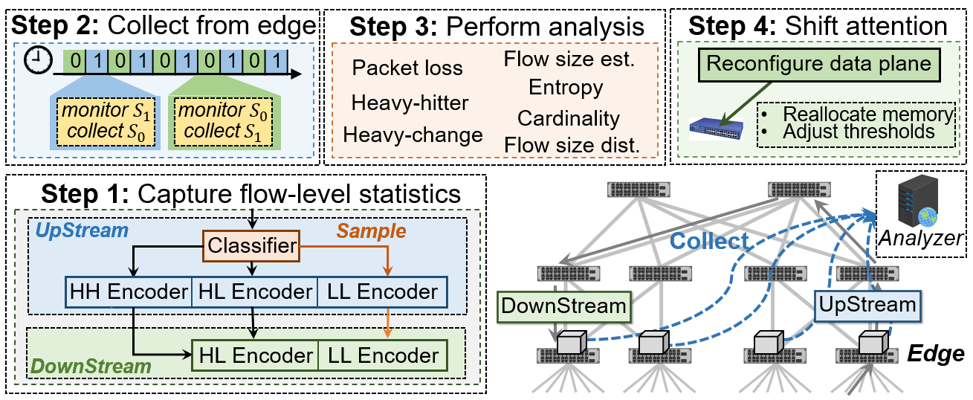
ChameleMon-Overview
Overview
Notes:
With FermatSketch, ChameleMon can then realize its key design to shift measurement attention as network state changes.
点击
Every measurement window, ChameleMon first captures flow-level statistics by implementing FermatSketches on edge switches, covering all the traffic entering and exiting the network.
点击
Second, ChameleMon collects sketches from edge switches.
点击
Third, ChameleMon performs network-wide analysis to obtain real-time network state with the collected sketches.
点击
Fourth, ChameleMon shifts measurement attention according to real-time network state by reconfiguring switch data plane.

Slide 17
ChameleMon-Design
Design philosophy
Healthy network state
Can record all victim flows
Record as many heavy-hitter (HH) candidates as possible
Ill network state
Cannot record all victim flows
Focus on heavy losses (HL) instead
Sample light losses (LL) to maintain overview of victim flows
Notes:
We then introduce the design philosophy of shifting measurement attention.
点击
When the network state is healthy, that there is enough memory to record all victim flows. At this time, ChameleMon should record as many heavy-hitter candidates as possible for accumulation tasks.
点击
When the network state is ill, that there is not enough memory to record all victim flows. At this time, ChameleMon should focus on recording heavy losses, which refer to victim flows suffering from severe packet losses.

Slide 18
ChameleMon-Design
Use flow size to classify HH, HL and LL candidates
Larger flows can lose more packets, be HL with higher prob.
Use TowerSketch as flow classifier
Use homogeneous FermatSketch as encoders
Swap memory between encoders at run-time (Attention)
UpStream
Sample
Classifier
HH Encoder
HL Encoder
LL Encoder
HL Encoder
LL Encoder
DownStream
18
Notes:
Based on the insight that larger flows can lose more packets, and thus have higher probability to become heavy loss.
ChameleMon uses flow size to classify Heavy hitter, Heavy loss, and light loss candidates,
ChameleMon uses a simple while accurate sketch, TowerSketch as flow classifier, and the detailed design is shown in the slides.
点击
For each packet, it is first classified into Heavy hitter, heavy loss or light loss candidate according to its flow size by classifier,
点击
Then, the packet is inserted into its corresponding FermatSketch encoder upstream and downstream.
点击
Because the FermatSketch encoders are homogeneous, when the network states varies, they can swap memory between themselves at run-time.
In this way, ChameleMon can record most heavy-hitter candidates in healthy network state, or focus on heavy-losses in ill network state, and thus meets attention requirement.

Slide 19
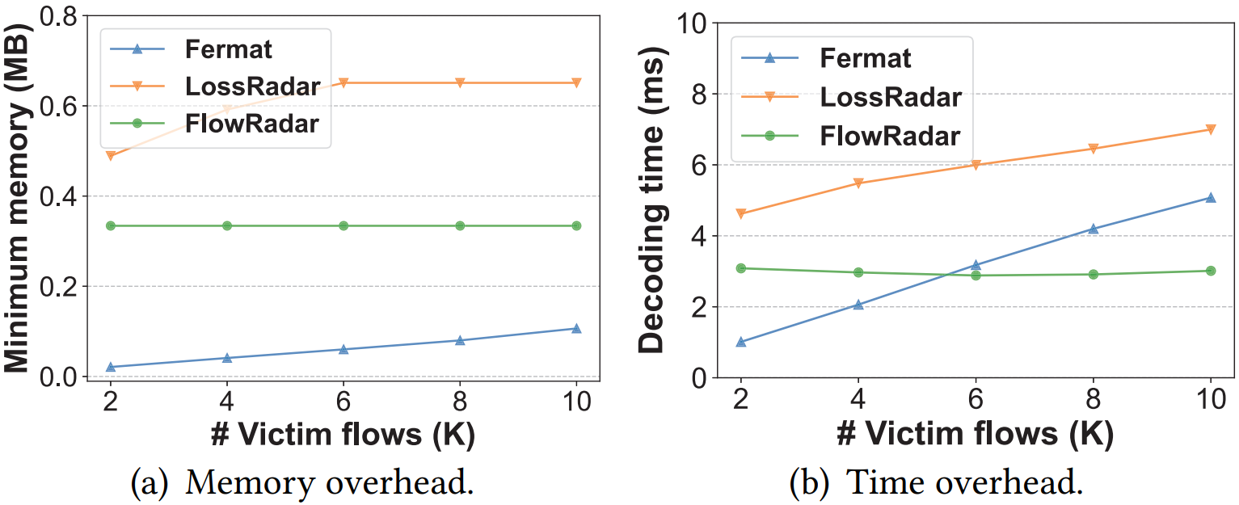
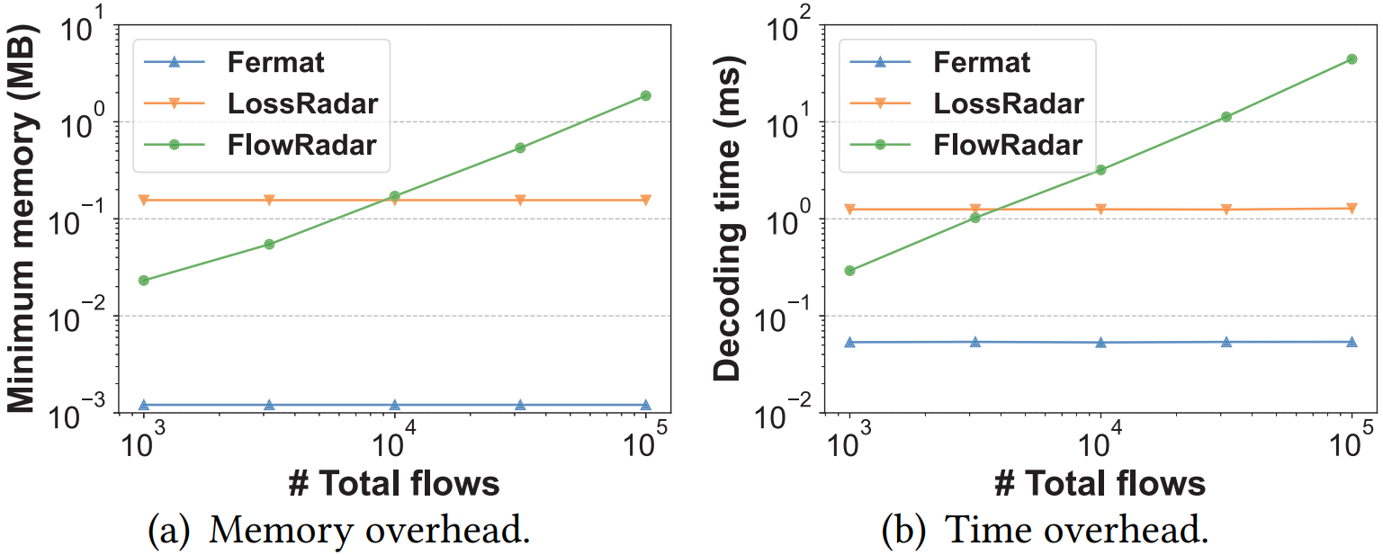
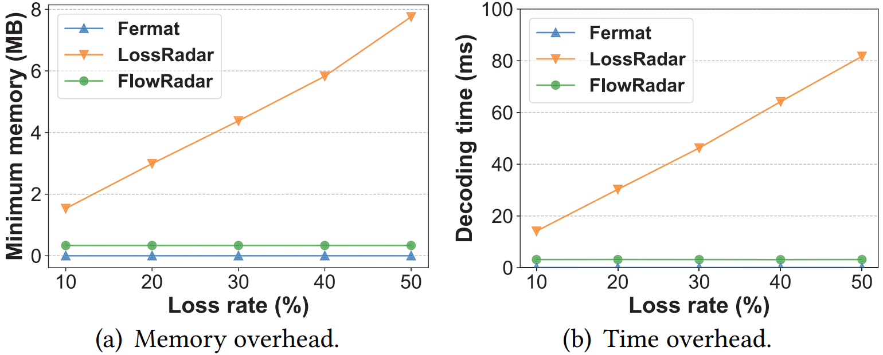
ChameleMon-Experiments
Packet loss detection
Simple Topology: one link
Best memory efficiency (O(# victim flows))
Notes:
Finally, we show the experimental results of ChameleMon.
点击
For packet loss detection, we find FermatSketch has best memory efficiency, with memory overhead proportional to the number of victim flows.
点击

Slide 20
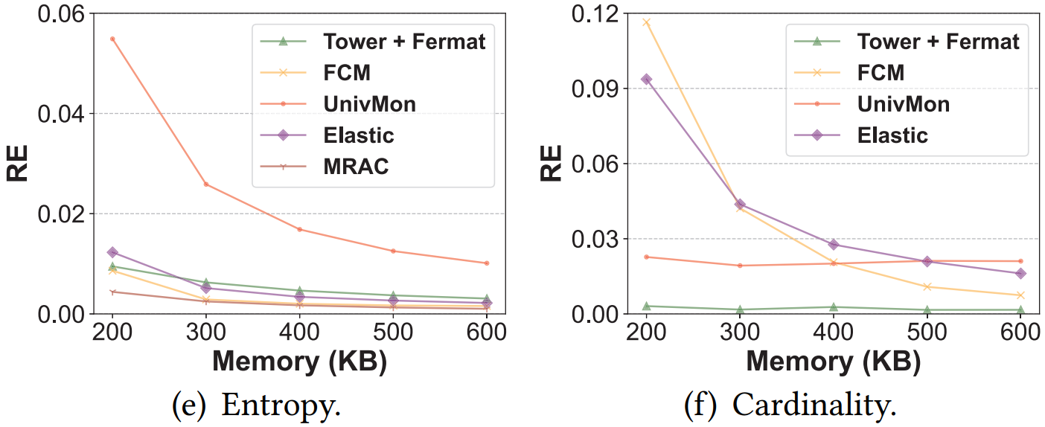
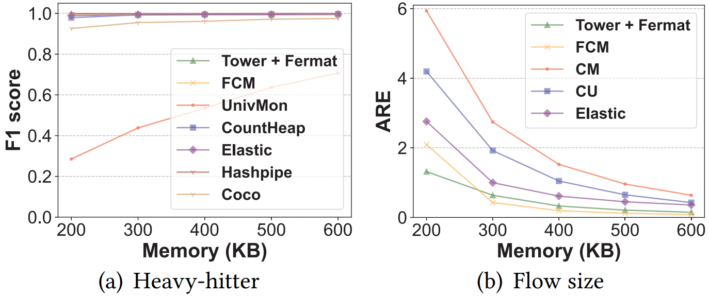
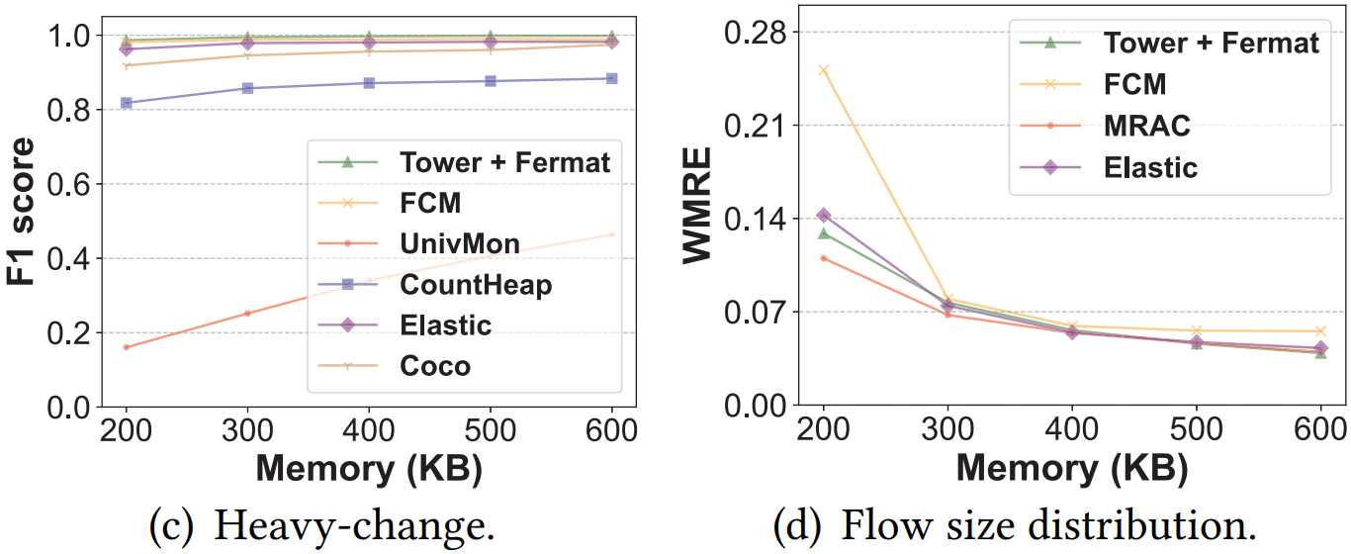
ChameleMon-Experiments
Packet loss detection
Simple Topology: one link
Best memory efficiency (O(# victim flows))
Six packet accumulation tasks
At least comparable accuracy with SOTA
Notes:
For six packet accumulation tasks, FermatSketch achieves at least comparable accuracy with the state-of-the-art solutions
点击

Slide 21
ChameleMon-Experiments
Testbed
Fat-tree: 10 Tofino and 8 end-hosts
DCTCP traffic
Notes:
To evaluate how can ChameleMon shift measurement attention, we have fully implemented a ChameleMon prototype on a testbed with 10 Tofino switches and 8 servers.

Slide 22
ChameleMon-Experiments
Manually change network state (#total flows/ratio of victim flows)
Shift measurement attention while maintaining high memory utilization
Notes:
We manually change network state, including the number of total flows and the ratio of victim flows.
点击
Results show that ChameleMon can successfully shift measurement attention while maintaining high memory utilization.
点击

Slide 23
ChameleMon-Conclusion
First system meets Versatility, Efficiency, and Attention Requirement
First system detects packet losses with O (#victim flows) memory
Fully Implemented on tested
Notes:
In conclusion,
点击
ChameleMon is the first system meets Versatility, Efficiency, and Attention Requirement at the same time.
点击
ChameleMon is also the first system supports packet loss detection with memory overhead proportional to the number of victim flows.
点击
We have fully Implemented ChameleMon on our testbed and extensive experimental results verify its effectiveness.

Slide 24
ChameleMon
Thank you!
Notes:
That’s all. Thank you for your listening.

