Slide 1
A Generic Technique for Sketches to Adapt to Different Counting Ranges
Tong Yang, Peking University, China
Jiaqi Xu, Peking University, China
Xilai Liu, Peking University, China
Peng Liu, ` Peking University, China
Lun Wang, Peking University, China
Jun Bi, Tsinghua University, China
Xiaoming Li, Peking University, China
Tong Yang, Peking University
yangtongemail@gmail.com
http://net.pku.edu.cn/~yangtong
Notes:
Hello, everyone. My name is Tong Yang. I am from Peking University.
Today my topic is about a new data structure for multi-set query.

Slide 2
Outline
PART 01
Background
PART 02
Our Approach
PART 03
Experimental results
PART 04
Conclusion
Notes:
Here is the outline, and we first introduce the background.

Slide 3
01
PART ONE
Background
Notes:
First, we introduce the defination and the application of multi-set query.

Slide 4
01
Background
Network measurements provide indispensable information for various network operations.
One important measurement is measuring the size of different flows (per-flow measurements for short).
Best solution: Sketch
1) Memory efficient 2) Constant and Fast speed
3) High accuracy

Slide 5
01
Background
Classic Sketch Algorithms for per-flow measurements:
1) CountMin (CM),
2) Conservative Update (CU),
3) Count (C),
4) Counter Tree

Slide 6
01
Background- CM sketches
Insertion
+1
+1
+1
+1
Query
37
30
’frequency: 25
= Min{37, 30, 25, 32}
25
32
Notes:
Here we show the most classic sketch: Count-min sketch, CM sketch for short.

Slide 7
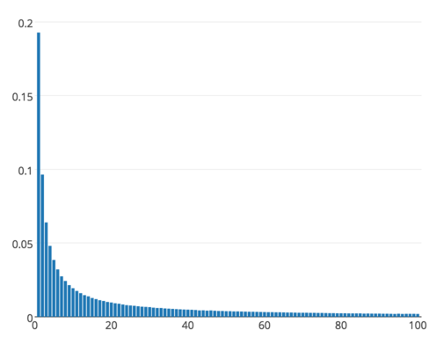
01
Background---traffic characteristics
Flow size distribution in real network:
1) Highly skewed
2) Majority: mice flows
3) Minority: elephant flows
4) No beforehand knowledge of flow size distribution
In such condition, existing sketches are inefficient in memory usage!

Slide 8
01
Prior sketches’limitations
For CM Sketch, CU Sketch and C Sketch:
large memory size
- Each counter needs to be large enough to store the largest flows
For Counter Tree:
Many memory accesses per insertion/query
- For each packet in an elephant flow, it needs to access all layers
Notes:
Many applications of multi-set query, such as filters for database index, allow mistakes, but mistakes still harm the performance: If there is a false positive for an queried element, the database will consider a tuple which is no in the disk to be in the disk, so there will be a waste disk access.

Slide 9
01
Design goal---make every bit count
Generic
- applicable to all sketches using counters
Memory efficient
- each small counter can be adaptive to the size of both mice and elephant flows
Constant and fast speed
- easy to use and do not introduce sophisticated data structure
Notes:
Many applications of multi-set query, such as filters for database index, allow mistakes, but mistakes still harm the performance: If there is a false positive for an queried element, the database will consider a tuple which is no in the disk to be in the disk, so there will be a waste disk access.

Slide 10
02
PART TWO
Our Approach
Notes:
Next, we present out solution – Cold filter

Slide 11
01
Rationale
SA Counter
Technique
02
Static Version
03
Dynamic Version
04
Case Study
Notes:
We explain our Elastic sketch in terms of the following six aspects.

Slide 12
02
SA (Self-Adaptive) Counter (Rationale)
Goal: use small counters to record the size of both elephant flows and mice flows.
Key idea：when a counter is going to overflow, for each insertion, instead of always increasing it, we increase it with a predefined probability.
Normal insertion
Insertion with a probability p, like $\frac{1}{4}$
Sign part
Counting part
Sign part
Counting part
0
0
0
0
0
1
0
1
1
0
0
0
0
0
0
1
inserting (e₄ , 2)
inserting (e₄ , 5)
0
0
0
0
0
1
1
1
1
0
0
0
0
0
1
1/0

Slide 13
02
Static Version -- insertion
$γ\left[0\right], … γ[k−1]$: the expansion array to determine the predefined probability $\frac{1}{γ[i]}$
Sign part: 2
Counting part: 31
$γ[2]$=4
0
1
0
1
1
1
1
1
Insertion
1) Increase the counting part by 1 with a predefined probability of $\frac{1}{γ[i]}$
2) If counting part overflows, sign part +1, counting part is set to 0.
inserting (e₄ , 2)
$γ[3]$=8
0
1
1
0
0
0
0
0
inserting (e₄ , 7)
$γ[3]$=8
0
1
1
0
0
0
0
1

Slide 14
02
Static Version -- deletion
$γ\left[0\right], … γ[k−1]$: the expansion array to determine the predefined probability $\frac{1}{γ[i]}$
Sign part: 3
Counting part: 31
$γ[3]$=8
0
1
1
0
0
0
0
1
Deletion
1) Decrease the counting part by 1 with a predefined probability of $\frac{1}{γ[i]}$
2) If counting part underflows, sign part -1, the bit of counting part is set to all 1.
deleting (e₄ , 7)
$γ[3]$=8
0
1
1
0
0
0
0
0
deleting (e₄ , 2)
$γ[2]$=4
0
1
0
1
1
1
1
1

Slide 15
02
Static Version -- query
$γ\left[0\right], … γ[k−1]$: the expansion array to determine the predefined probability $\frac{1}{γ[i]}$
Query
$$stage\left[0\right]=0,$$
$$stage\left[i\right] = 2^{n−s}×\sum_{j=0}^{i−1}{γ\left[j\right]} i>0$$
Value = $c_{0}×γ\left[s_{0}\right]+stage[s_{0}]$
Sign part: 2
Counting part: 31
$γ[2]$=4
0
1
0
1
1
1
1
1
Value=476
inserting (e₄ , 1)
$γ[3]$=8
0
1
1
0
0
0
0
0
Value=480
inserting (e₄ , 7)
$s$: the number of digits of sign part
$c_{0}$: the value of counting part
$s_{0}$: the value of sign part
$γ[3]$=8
0
1
1
0
0
0
0
1
Value=488

Slide 16
02
Dynamic Version
Problem in static version: space taken by sign part is fixed and not easily adjustable for the size of mice flows.
Dynamic version: introduce a split bit and dynamically adjust the length of counting part, thus Self Adaptive.
Split bit
Split bit: the leftmost zero bit, use it to divide sign part and counting part
Sign part
Counting part
1
…
1
0
1/0
…
…
1/0

Slide 17
02
Dynamic Version -- insertion
$γ[0]$=1
0
1
1
1
1
1
1
1
Insertion
1) Increase the counting part by 1 with a predefined probability of $\frac{1}{γ[i]}$
2) If counting part overflows,
set counting part to 0, short it by 1 bit,
move split bit right by 1 bit,
lengthen sign part by 1 bit.
inserting (e₄ , 1)
$γ[1]$=2
0
0
0
0
0
0
0
0
1
0
……
$γ[3]$=8
1
1
1
0
1
1
1
1
inserting (e₄ , 7)
$γ\left[0\right], … γ[k−1]$: The expansion array to determine the predefined probability $\frac{1}{γ[i]}$
$γ[4]$=16
0
0
1
1
1
1
0
0
0
0

Slide 18
02
Dynamic Version -- deletion
$γ[4]$=16
1
1
1
1
0
0
0
0
Deletion
1) decrease the counting part by 1 with a predefined probability of $\frac{1}{γ[i]}$
2) If counting part downflows,
set counting part to 1, lengthen it by 1 bit,
move split bit left by 1 bit,
short sign part by 1 bit.
deleting (e₄ , 7)
$γ[3]$=8
1
1
1
1
0
0
1
1
1
1
……
$γ[1]$=2
1
0
0
0
0
0
0
0
deleting (e₄ , 1)
$γ\left[0\right], … γ[k−1]$: The expansion array to determine the predefined probability $\frac{1}{γ[i]}$
$γ[0]$=1
0
1
1
0
1
1
1
1
1
1

Slide 19
02
Dynamic Version -- query
$γ[0]$=1
Query
$$stage\left[0\right]=0,$$
$$stage\left[i\right] = \sum_{j=0}^{i−1}{(γ\left[j\right]}×2^{n−j−1}) i>0$$
Value = $c_{0}×γ\left[s_{0}\right]+stage[s_{0}]$
0
1
1
1
1
1
1
1
Value=127
inserting (e₄ , 1)
$γ[1]$=2
0
0
0
0
0
0
0
0
1
0
Value=128
……
$γ[3]$=8
1
1
1
0
1
1
1
1
Value=504
inserting (e₄ , 7)
$γ\left[0\right], … γ[k−1]$: The expansion array to determine the predefined probability $\frac{1}{γ[i]}$
$γ[4]$=16
0
0
1
1
1
1
0
0
0
0
Value=512

Slide 20
02
Case Study- CM sketches
content in a SA Counter
(dynamic version)
All are SA Counters
Insertion
+1/0
+1/0
1
0
0
0
0
1
0
0
+1/0
+1/0
Query
136
122
’frequency: 122
= Min{136, 122, 125, 126}
125
126
137 in a normal counter
Notes:
Here we show the most classic sketch: Count-min sketch, CM sketch for short.

Slide 21
02
Case Study- CU sketches
content in a SA Counter
(static version)
All are SA Counters
Insertion
+1/0
0
1
1
0
0
0
0
0
Query
Min value among all hashed counters
128
118
’frequency: 118
= Min{128, 118, 123, 123}
123
123
137 in a normal counter
Notes:
Here we show the most classic sketch: Count-min sketch, CM sketch for short.

Slide 22
03
PART THREE
Experimental Results
Notes:
Next, we present the implementations

Slide 23
03
Experiments (Setup)
Dataset: CAIDA, synthetic dataset
CAIDA:
Trace Date #packets #flows (SrcIP)
CAIDA1 2015/02/19 1164.9M 2.6M
CAIDA2 2015/05/21 1081.0M 3.9M
CAIDA3 2016/01/21 1835.1M 8.9M
CAIDA4 2016/02/18 1799.7M 8.4M
Synthetic dataset: following Zipf distribution ($p\left(x\right)=\frac{x^{−a}}{ζ(a)}$), from 0 to 3.0 with a step of 0.3
Notes:
This is the experimental setup.

Slide 24
03
Experiments (Setup)
Metrics:
ARE, AAE, Per-Flow memory consumption, Per-Packet memory consumption, Throughput
Comparisons:
CM, CU, C with original counter, CM, CU, C Sketch with SA Counter and Counter Tree
Notes:
This is the experimental setup.

Slide 25
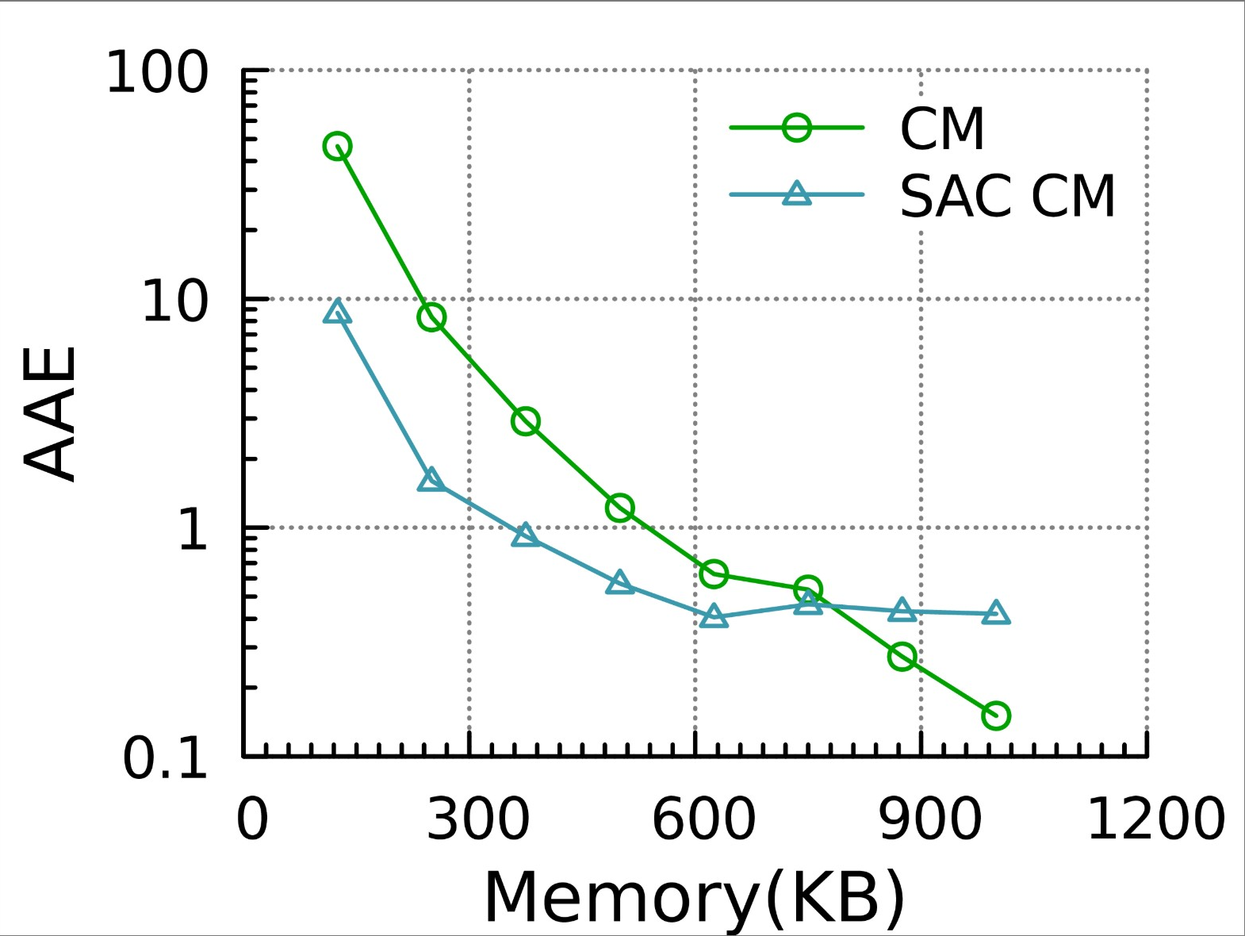
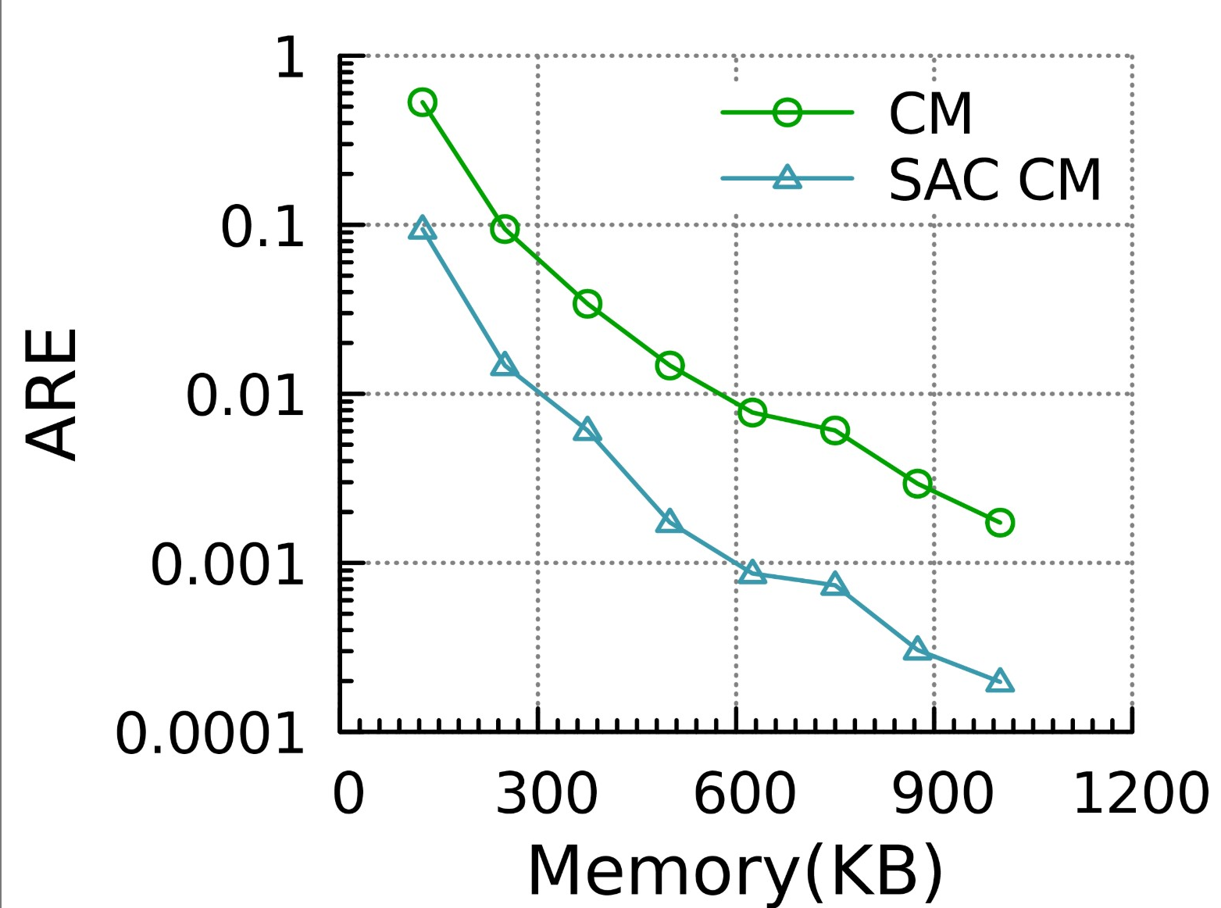
03
Experiments (Accuracy---flow volume)
Dataset: CAIDA

Slide 26
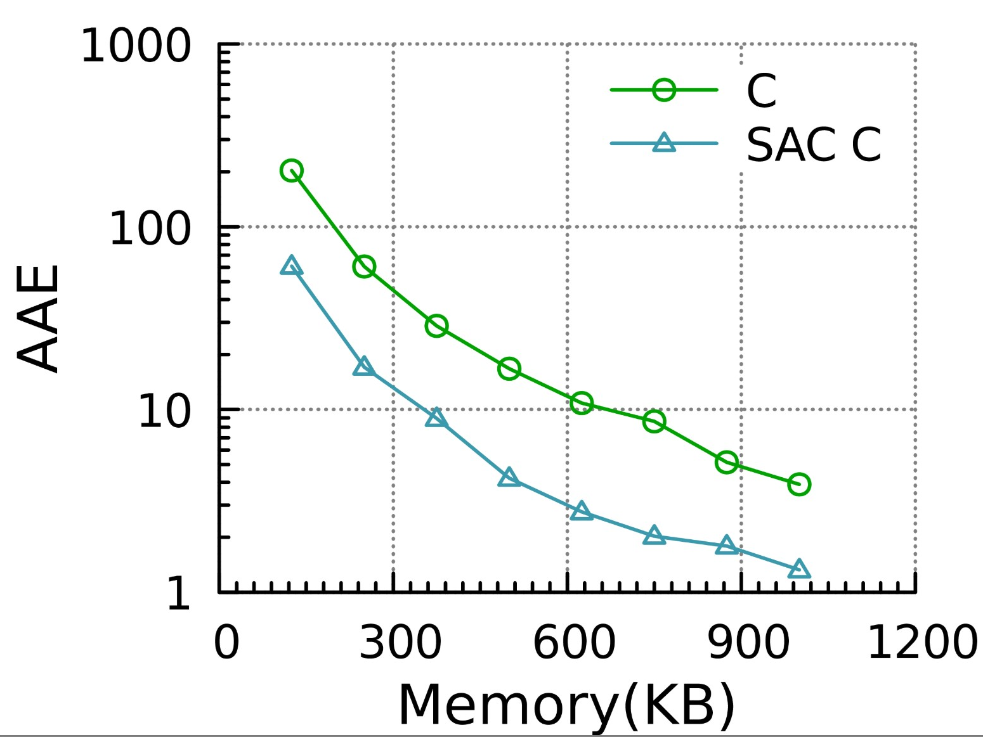
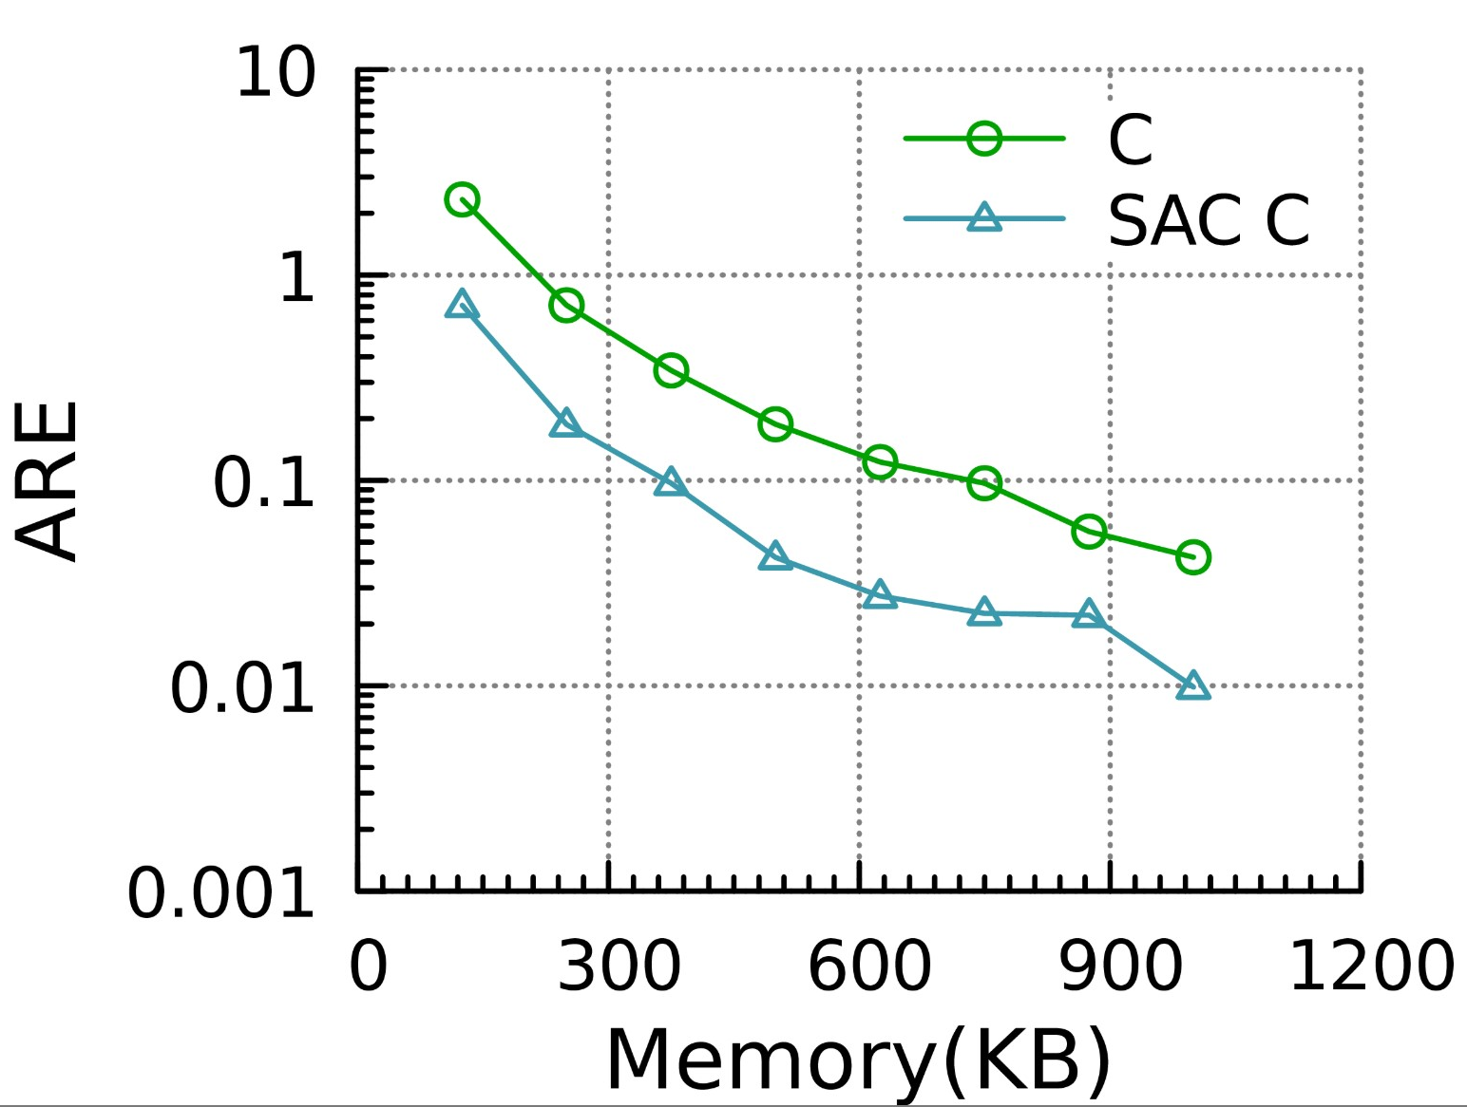
03
Experiments (Accuracy---flow volume)
Dataset: CAIDA

Slide 27
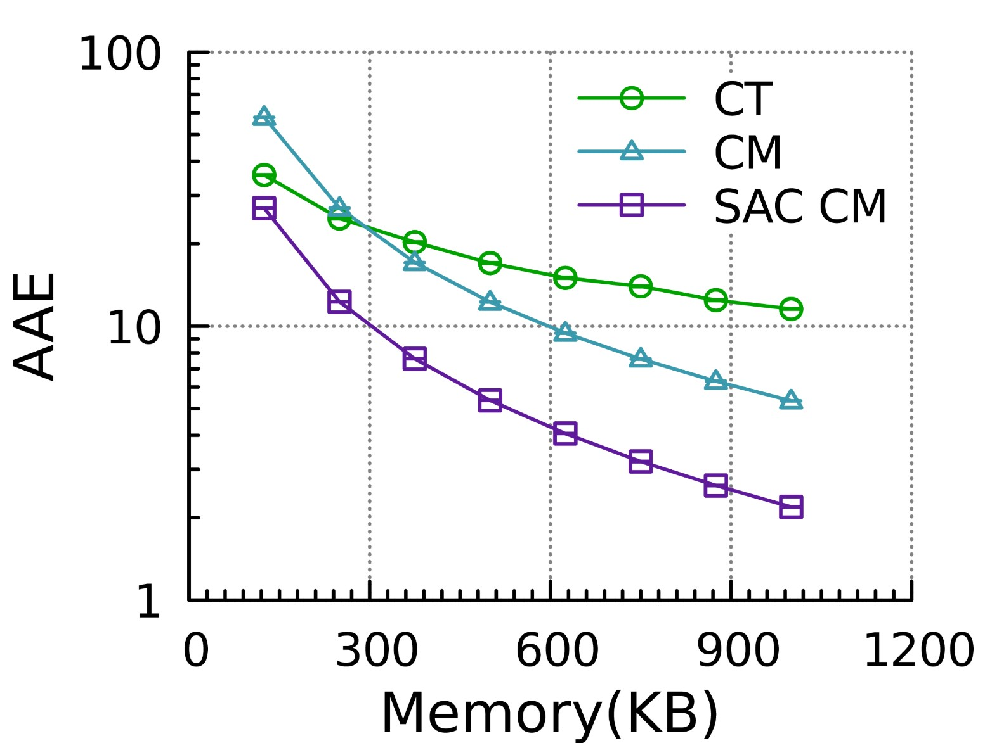
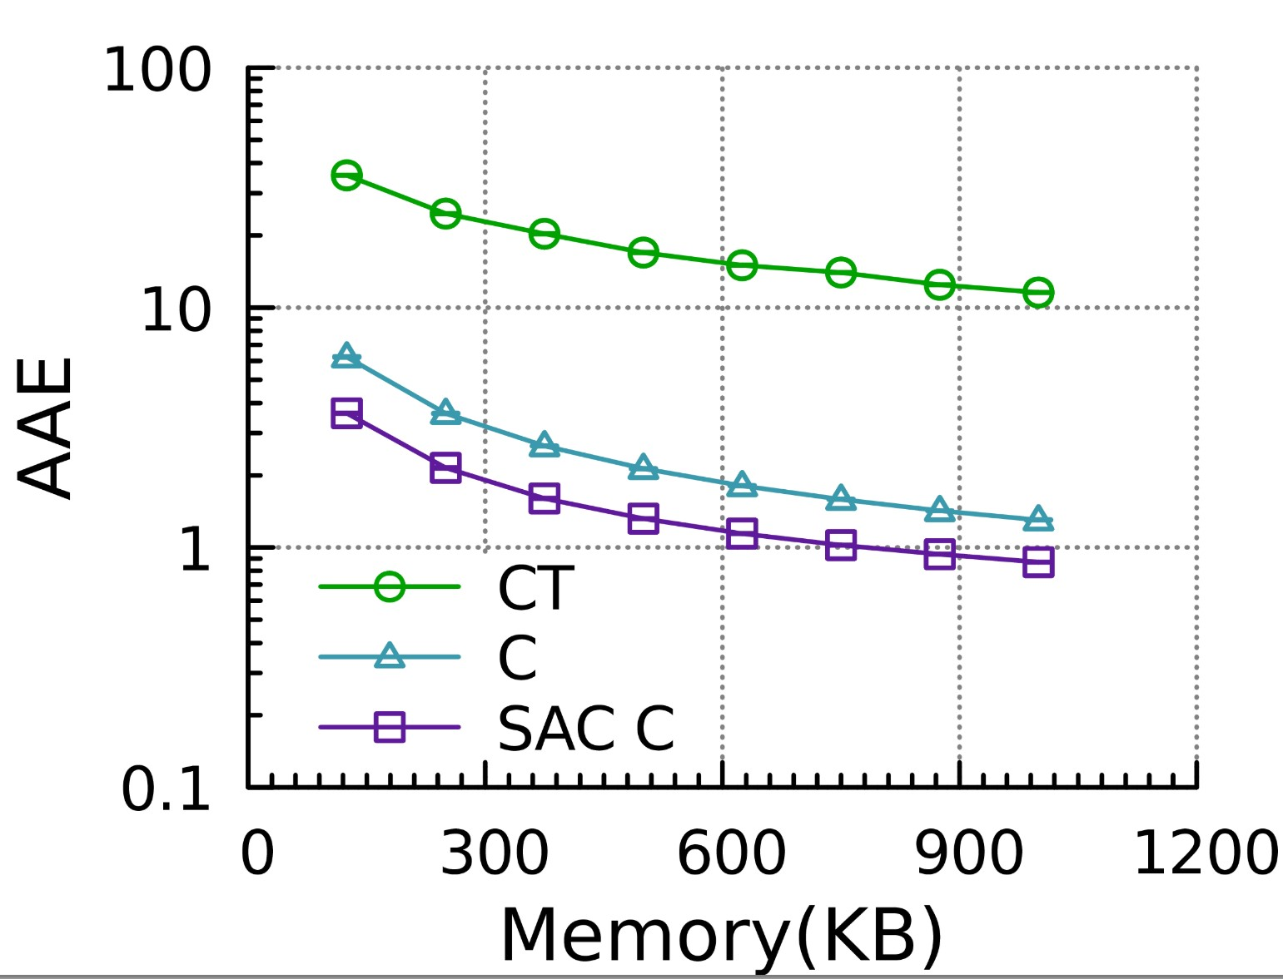
03
Experiments (Accuracy---flow size)
Dataset: Synthetic dataset (skewness: 1.5)

Slide 28
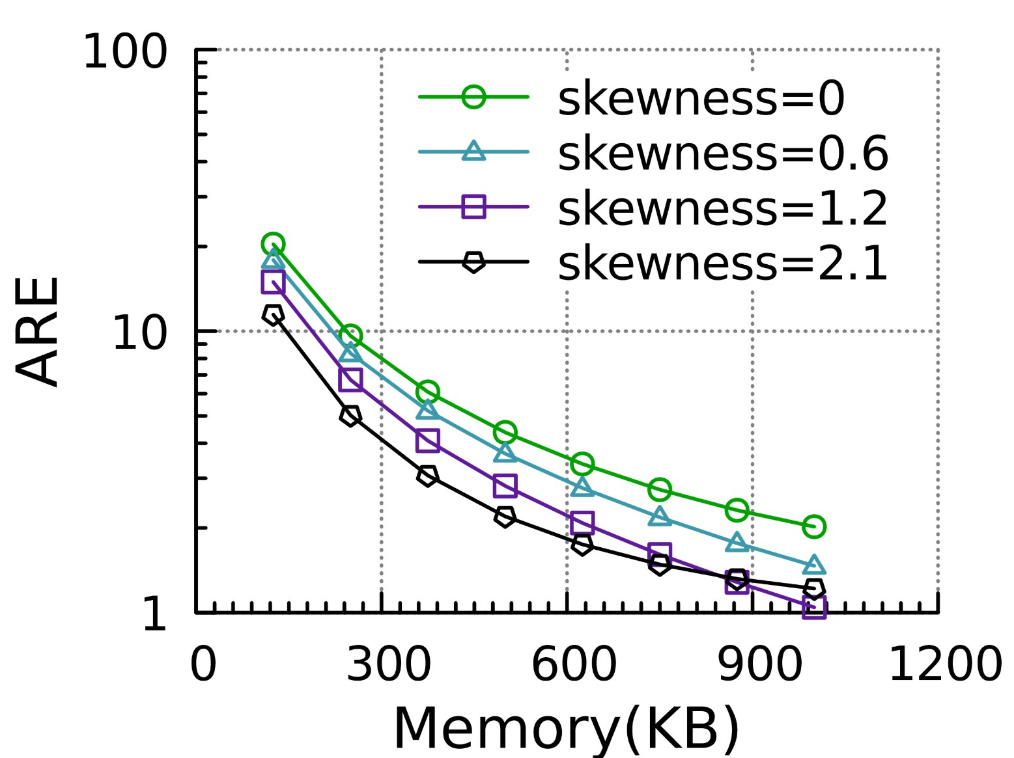
03
Experiments (Skewness analysis)

Slide 29
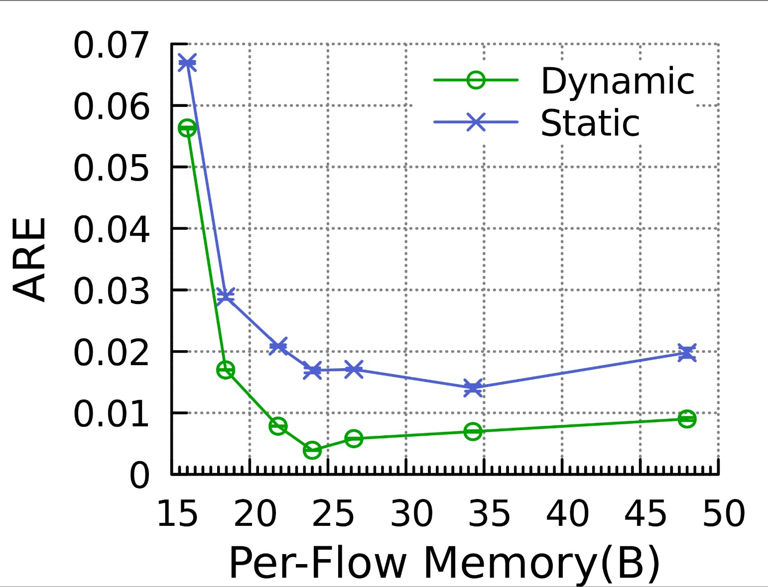
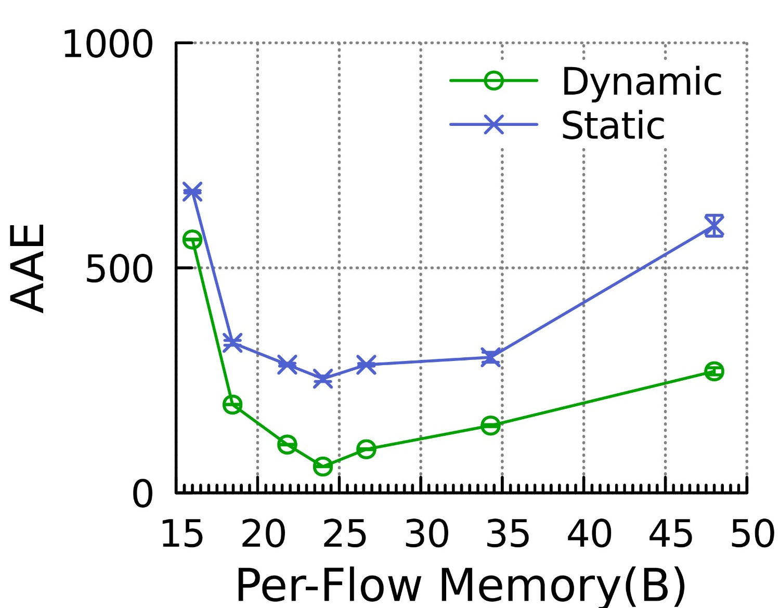
03
Experiments (Dynamic vs Static version)
The accuracy of the dynamic version is better than that of static version.

Slide 30
04
PART FOUR
Conclusion
Notes:
Next, we present out solution – Cold filter

Slide 31
04
Conclusion
We propose a generic technique named Self-Adaptive Counters (SA Counter) with two versions: dynamic and static version.
generic (applicable to all sketches using counters)
small memory usage (nearly ½ of the original memory usage)
Better and simpler than Counter Tree
The dynamic version is better than the static version

Slide 32
THANKS
Tong Yang
Peking University, China
Email: yangtongemail@gmail.com
Homepage: http://net.pku.edu.cn/~yangtong/
Notes:
Thanks.

