Slide 1
Newton sketches: Estimating Node Intimacy in Dynamic Graphs Using Newton’s Law of Cooling
ICDE 2024, May 13-17, 2024, Utrecht，Netherlands.
Qizhi Chen†, Ke Wang‡, Aoran Li†, Yuhan Wu†, Tong Yang†, Bin Cui†
† Peking University, China
‡Yale University, New Haven, CT, USA
Notes:
Hello everyone, I’m Qizhi Chen from Peking University. I’m going to introduce Newton sketches: Estimating Node Intimacy in Dynamic Graphs Using Newton’s Law of Cooling

Slide 2
01
Part One
Background
Notes:
Let’s start with the background of the sketch, and some existing work.

Slide 3
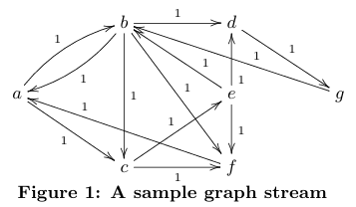
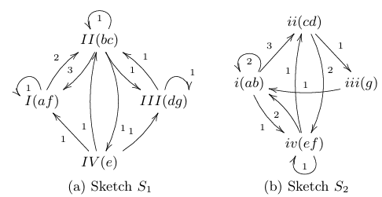
Dynamic Graphs and Sketches
Dynamic graphs are vital in various real-world applications.
They handle large volumes and high dynamicity, often needing approximation methods.
Notes:
dynamic graphs, which are crucial in applications like social networks, recommendation systems, and network traffic monitoring.
Due to the continuous changes in these graphs, traditional algorithms maybe fall short. Probabilistic algorithms, which offer approximate but efficient solutions, come to the rescue. There are two main approaches in this domain: sampling and sketches.
my work focus on sketch techniques used in dynamic graphs. Sketch involves creating a compact data structure that summarizes the information of a graph. This method significantly reduces memory usage and computational time.
But we found that existing sketches primarily estimate frequencies, which are sometimes not useful for dynamic graph tasks that change over time. We propose a new estimate: node intimacy.

Slide 4
Social Networks
Traditional measure: counting interactions (frequency).
Friends' interaction counts.
Frequency example: 100 messages 10 years ago vs. 100 recent messages.
Notes:
To illustrate the value of the node intimacy concept, let's consider social networks. These networks are dynamic, evolving as time progresses. Traditionally, we might measure the relationship between friends by counting their interactions, which corresponds to the edge frequency in dynamic graphs. For instance, we could count how many messages friends have exchanged over time.
However, there's a significant limitation to this frequency-based approach. Imagine we have two friends: one exchanged 100 messages 10 years ago, and another just exchanged 100 messages recently. If we only consider frequency, both friends appear equally familiar. Yet, intuitively, we understand that friends who have interacted recently are likely more familiar with each other now.

Slide 5
Recommendation Systems
User preferences change over time.
Dynamic recommendation systems must consider time.
User's past interest vs. current interest.
Notes:
To further illustrate the value of node intimacy, let's consider recommendation systems. User preferences are dynamic and change over time. In a dynamic recommendation system, it's crucial to account for these changes when calculating user preferences for products. Relying solely on traditional frequency-based methods can be inadequate.

Slide 6
Node Intimacy
Node Intimacy should increase with new interactions or edges.
Node Intimacy should be time-sensitive.
Node Intimacy should continuously decrease over time.
Notes:
To understand the concept of node intimacy, we first need to establish its properties. Node intimacy should increase whenever there are new interactions or when a new edge appears in the graph. Additionally, it must be time-sensitive, meaning the value of older edges should diminish compared to newer edges. This ensures that the intimacy measure accurately reflects the current state of the graph.
Given the time-sensitive nature of node intimacy, if we consider intimacy as a specific value, it should continuously decrease over time. This decay process is very similar to how temperature changes in nature. For example, consider a cup of hot water that cools down over time. And if adding more hot water increases the temperature again.
So we apply Newton's Law of Cooling, which describes how temperature changes over time. According to this law, the temperature of an object decreases exponentially as it cools down. Similarly, node intimacy should increase with new interactions and decay over time in an exponential manner.

Slide 7
02
Part Two
Algorithms
Notes:
Next, we introduce our Newton sketches

Slide 8
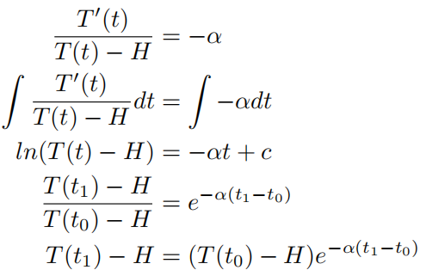
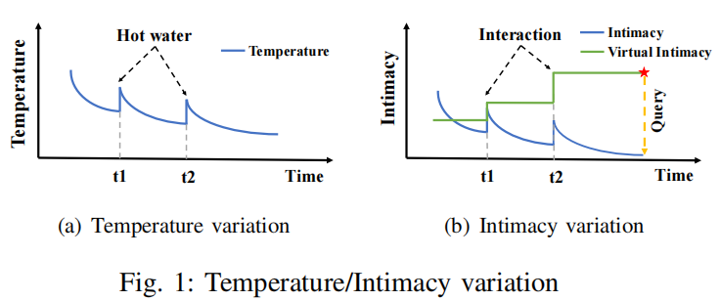
Newton-Observe
Virtual Intimacy
Notes:
Let's delve into the algorithmic innovations behind our approach, starting with Newton-Observe.
The basic method we called DPU, while effective, requires extra storage for timestamps, adding complexity.
when we ask for some edge，the timestamp can help us ti calculate the intimacy now
By studying Newton's Law of Cooling, we designed Newton-Observe. This approach allows us to record only Virtual Intimacy, simplifying the data structure while maintaining accuracy in measuring node intimacy.

Slide 9
Newton-Observe
Notes:
Let's delve into the algorithmic innovations behind our approach, starting with Newton-Observe.
The basic method we called DPU, while effective, requires extra storage for timestamps, adding complexity.
when we ask for some edge，the timestamp can help us ti calculate the intimacy now
By studying Newton's Law of Cooling, we designed Newton-Observe. This approach allows us to record only Virtual Intimacy, simplifying the data structure while maintaining accuracy in measuring node intimacy.

Slide 10
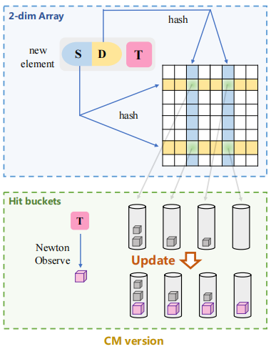
CM Version and CU Version
Notes:
The first variant of Newton Sketch is the Count-Min (CM) version. This version employs a two-dimensional array and uses hash functions to map edges to cells within the array. By leveraging these hash functions, the CM version efficiently handles edge queries while maintaining a low memory overhead, making it suitable for large-scale dynamic graphs.

Slide 11
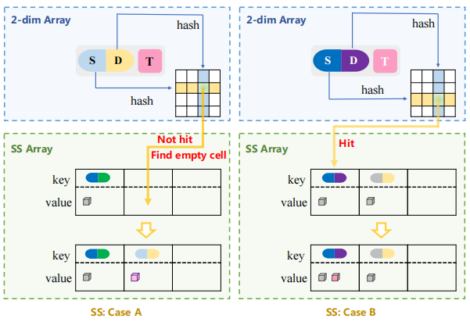
Space-Saving Version
Notes:
Next, we have the Space-Saving (SS) version of Newton Sketch. This version is designed to store the top-k edges within each bucket, making it particularly effective for local top-k queries. The SS version strikes a balance between memory usage and query accuracy, ensuring that the most significant edges are retained and easily retrievable.

Slide 12
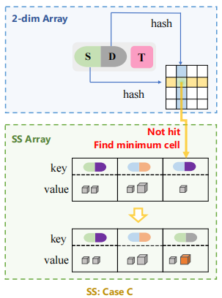
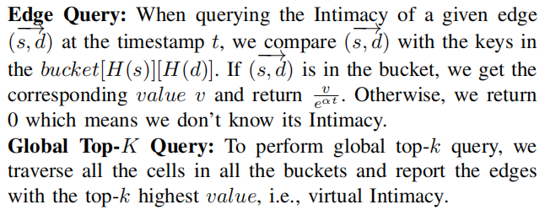
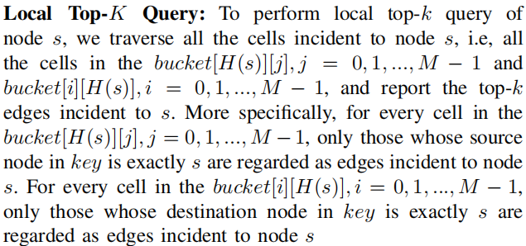
Space-Saving Version
Notes:
Next, we have the Space-Saving (SS) version of Newton Sketch. This version is designed to store the top-k edges within each bucket, making it particularly effective for local top-k queries. The SS version strikes a balance between memory usage and query accuracy, ensuring that the most significant edges are retained and easily retrievable.

Slide 13
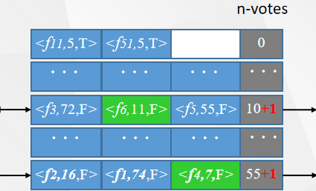
Elastic Version
Combines the advantages of the CM version and the SS version.
Perfectly achieving both global Top-k tasks and edge query tasks simultaneously.
f8
f8
f9
f4
Light part: CM Version
Heavy part: 2-dim Elastic with Newton-Observe
Notes:
Finally, we introduce the Elastic version of Newton Sketch. This variant combines heavy and light parts to manage both edge query and global and local top-k queries. The heavy part focuses on storing the most significant edges, while the light part handles the remaining edges. This adaptive approach allows the Elastic version to perform well under varying memory constraints and diverse query types, making it a versatile tool for dynamic graph analysis.

Slide 14
03
Part Three
Experiments
Notes:
Next, we show some of the selected experimental results.

Slide 15
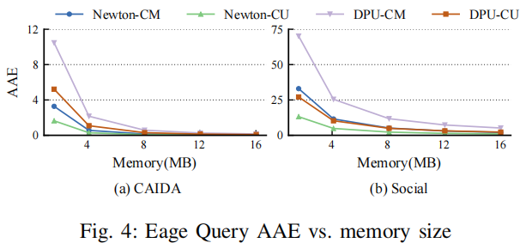
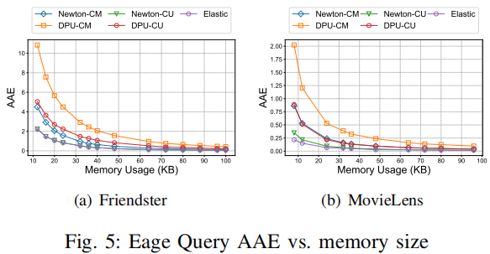
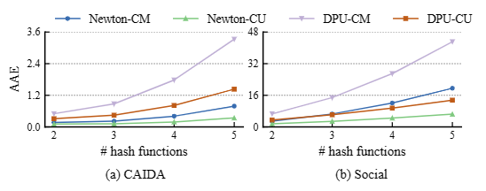
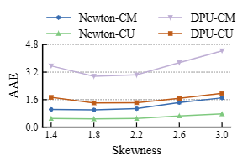
Experiments on Eage Query
Notes:
The first part of our experiments focused on edge query, which is the most basic and crucial task in dynamic graphs. We compared the performance of Newton-Observe with traditional methods. Our results demonstrated significant improvements in both accuracy and efficiency, showcasing the effectiveness of Newton-Observe for this fundamental task.

Slide 16
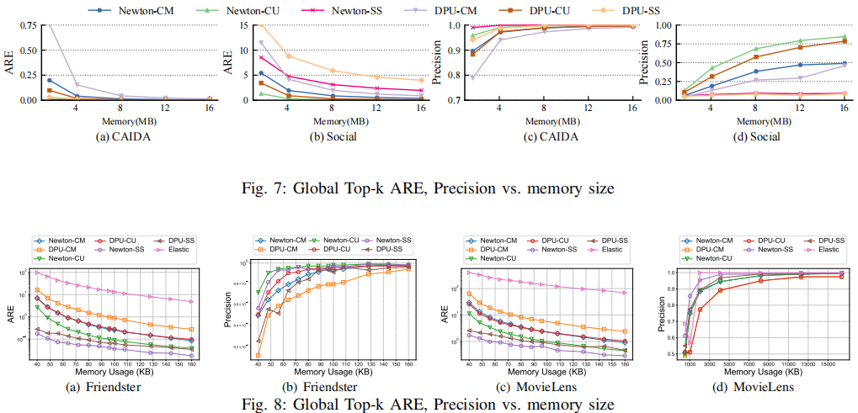
Experiments on Global Top-k
Notes:
The second part of our experiments evaluated the global top-k task, which is particularly useful for assessing node intimacy. We tested Newton-Observe against other leading techniques.
The results indicated that Newton-Observe achieved better precision and lower error rates, proving its utility in identifying the most significant relationships in a dynamic graph

Slide 17
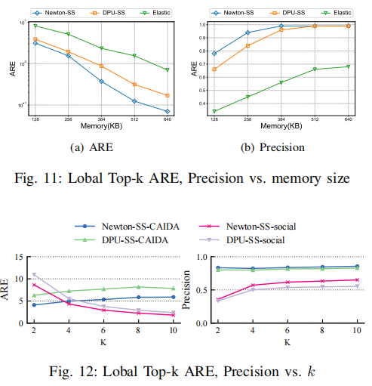
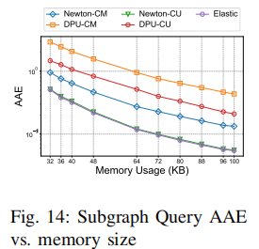
Experiments on Lobal Top-k and Subgraph Query
Notes:
In the final part of our experiments, we tested Newton-Observe on various other graph queries to demonstrate its versatility.
These tasks included local top-k and subgraph queries, among others. Across all these tests, Newton-Observe consistently showed broad applicability and robust performance, highlighting its potential as a comprehensive solution for dynamic graph analysis.

Slide 18
Thank you
Our code is open-source!
https://github.com/NewtonSketch/NewtonSketch
Notes:
That is my talk. Our cold is open-sourced in Github. Thank you!

