Slide 1
MicroscopeSketch: Accurate Sliding Estimation
Using Adaptive Zooming
Yuhan Wu, Shiqi Jiang, Siyuan Dong, Zheng Zhong, Jiale Chen, Hu Yutong, Tong Yang, Bin CUI, Steve Uhlig. KDD 2023
Notes:
Hello everyone, I’m Yuhan Wu from Peking University. Today, I will present our paper titled “MicroscopeSketch: Accurate Sliding Estimation Using Adaptive Zooming.” Thank you for joining me today. Let's get started!

Slide 2
Background and Motivation
Data Streams
Frequency Estimation
Sliding Windows
Time
A
B
C
A
E
E
A
A
F
Sliding Window (9 most recent items)
What’s the frequency of “A”? 4 items
Notes:
In today's digital era, vast volumes of data are generated in real-time. When sequenced chronologically, these form what we term as data streams. For various tasks that have pressing real-time demands, data analysts are tasked with processing these streams instantaneously.
Our research concentrates on one of the most foundational tasks in data stream processing: frequency estimation. Simply put, it means counting how many times each item appears.
Many classical approaches aim to estimate frequencies across the whole data stream or over a fixed time range. However, our attention is on a more time-sensitive model called the sliding window. As time advances, this sliding window shifts to include the most recent item. The window's size can be determined based on actual elapsed time or by the number of contained items.
Our illustration offers a glimpse into this concept: the input is a data stream, with each data item associated with an ID. Within the depiction is a sliding window that encapsulates nine items. As each new item emerges, the window adjusts by eliminating the oldest item. At any moment, a user might inquire about the frequency of a specific ID.
Our goal is to design a data structure adept at monitoring the frequencies of items within the sliding window in real-time.
We are striving to craft an algorithm for sliding window frequency estimation that, under equivalent memory overheads, improves the accuracy of existing solutions.

Slide 3
Related Work
Count-Min Sketch: A ready-to-use approximate algorithm for frequency estimation
4
0
1
6
3
5
0
2
$${Hash}_{1} (A)$$
Query A ? 4 times.
Insert item A
$${Hash}_{2} (A)$$
Query $B$ ? 2 times.
$${Hash}_{3} (A)$$
Insert:
Increment All Hashed Counters
Query:
Report the minimum counter
Notes:
Before we go further, let's introduce a basic and effective counting algorithm. If we want to estimate frequencies over the whole data stream instead of just the sliding window, we can use a popular tool known as the Count-Min Sketch. Think of it as a counter list that can do two things: insert an item and query its frequency.
Every time we insert an item, we calculate three hash values and increase three counters based on those values. If you want to know the frequency of an item, you'd look at the smallest number among the three counters – that's your answer.
However, this algorithm isn't ready for sliding windows. Why? Because it's good at inserting items but can't remove old ones, especially those that move out of the sliding window as time goes on.
-------------------------------------------

Slide 4
Related Work: Sliding sketch (KDD’20)
Count-Min Sketch 1
Sketch 2
Sketch 3
Sub-window 1
Sub-window 2
Sub-window 3
Time
A
B
C
A
E
E
A
A
F
Sliding Window (9 most recent items)
Notes:
Indeed, the state-of-the-art (SOTA) approach for sliding window estimates has some limitations. The method involves breaking down the timeline into multiple fixed-size windows and maintaining a count-min sketch for each. To calculate the frequency within the sliding window, the estimated results from the most recent fixed windows are summed up.
An example of this approach is the Sliding Sketch method, which was presented at KDD in 2020. But, in our observation, it doesn't make the best use of space and it's not that precise. The issue lies in the fact that when there's only so much space available, it maintains multiple sketches separately. This makes each sketch narrower and there's a higher chance that hash values will overlap. This eventually makes the algorithm less accurate. Our aim is to improve on this, by making better use of space and achieving higher precision with the same amount of total space.

Slide 5
Insight
Similarity
The counter values at these identical positions show certain similarities.
Each sub-window need a large counter to keep frequency, which leads to memory waste.
A
A
A
Sub-window 1
Sub-window 2
Sub-window 3
Time
A
B
C
A
E
E
A
A
F
Sliding Window (9 most recent items)
Notes:
Our key insight revolves around leveraging the similarity of counter values across different sketches. When they use the same hash functions, an item that's frequently present in multiple sub-windows gets hashed to the same position in different sketches. The counter values at these identical positions show certain similarities.
For instance, if item A pops up a lot, its frequency will be high across various sub-windows. This means that many of its hashed counters will have relatively big numbers. Other counters, which don't get hit by high-frequency items, will have much smaller values. If we set all counters to be large, it would waste storage space.
Building on this observation about counter similarity, we've developed a dynamic counter compression technique.

Slide 6
MicroscopeSketch (MicroSketch)
Adaptive zooming
Reorder counters
Store Consecutively
Column First
Row First
Notes:
The solution we present in this paper is called MicroscopeSketch, which is anchored around the key technique called Adaptive Zooming. It employs the floating-point representation to condense similar counters efficiently.
Our first move is to sort out and rearrange these counters. We find the counters that occupy the same positions across the sketches for each sub-window, then we store these counters sequentially. We change the storage method from "Column First" to "Row First", as shown in the figure. This way, counters that have the same index in different sketches are lined up next to each other, since they're likely to be similar.

Slide 7
MicroscopeSketch (MicroSketch)
Adaptive zooming
Float-point number representation
$frequency=a×c^{b}$
a: the significand of frequency. Each sub-window has independent significand.
b: the integer exponent of frequency. All sub-windows share the same one.
c: the pre-defined parameter.
Dynamically alters the granularity of count
Adjust exponent b
A row of counters
F1 F2 F3
$$a1×c^{b}$$
$$a2×c^{b}$$
$$a3×c^{b}$$
$a1 a2 a3$ b
Actual Storage
Notes:
For every row of counters, we introduce a novel representation method that draws on floating-point numbers. Every counter within the sketch is characterized as a product of "a" and "c" raised to the exponent "b".
Here, "a" represents the significant digit of the floating-point number, with each sub-window having its unique significant digit. "b" serves as the exponent and remains consistent across all sub-windows, while "c" is a predetermined constant.
The size of the exponent "b" can be dynamically modulated based on the magnitude of the frequency, facilitating a more accurate estimation.

Slide 8
MicroscopeSketch (MicroSketch)
$$frequency=a×c^{b}$$
Data structure
T+2 pixel counters (P[0], P[1],…, P[T+1]): $l$ bit (e.g., $4 bit$), record the value of a in T+2 sub-windows.
A zooming counter Z: 5 bit, record the value of b.
A shutter counter S: record the sum of
the frequency of the current sub-window, and
the remaining frequency of the previous sub-window.
Notes:
Alright, let‘s dive a bit deeper into the specifics of how this data structure is put together.
Let's visualize our sliding window as having a size of W. This window is exactly the sum of T sub-windows. The first thing we do is use T+2 pixel counters to capture the information from the most recent T+2 sub-windows. What we're really recording here is the value ‘a’. It requires l bits, usually sitting at 4 bits, which is quite a bit less than the 32 bits typically used in conventional sketches.
Next up, we bring in a zooming counter, Z. This one is here to keep track of the value of b. We've nicknamed it the "zooming counter" because when we adjust it, it can effectively perform a scaling function.
Then, we employ a shutter counter, S. This counter is responsible for registering those leftovers that can't be fully represented by a floating point. This encompasses the remaining part from the counter of our current sub-window, as well as any leftovers from previous windows.

Slide 9
MicroscopeSketch (MicroSketch)
$$frequency=a×c^{b}$$
Data structure
T+2 pixel counters (P[0], P[1],…, P[T+1]): $l$ bit (e.g., $4 bit$), record the value of a in T+2 sub-windows.
A zooming counter Z: 5 bit, record the value of b.
A shutter counter S: record the sum of 1) the frequency of the current sub-window and 2) the remaining frequency of the previous sub-window.
Why we need T+2 pixel counters?
zero counter
${(T+1)}^{th}$ sub-window
T=8
Notes:
Now, you might be wondering: why, when our sliding window consists of T sub-windows, are we using T+2 pixel counters? Let me visualize this for you. Picture a series of blocks, with each representing a sub-window. Their positions are static; they don't slide over time. However, our focus, the sliding window, does move.
On the far right, a deep blue block represents the most recent sub-window. The present moment is somewhere in the midst of this block. Next to it, you see light blue blocks. These denote the windows that are currently overlapping with our sliding window W (we'll call these "active"). All but the oldest one on the far left are fully enclosed by the sliding window.
Now, a grey block to the left of the oldest light blue one. This signifies a sub-window that's no longer part of the sliding window. For recording purposes, we use T+2 pixel counters: T for the light blue windows, and one each for the deep blue and grey windows.

Slide 10
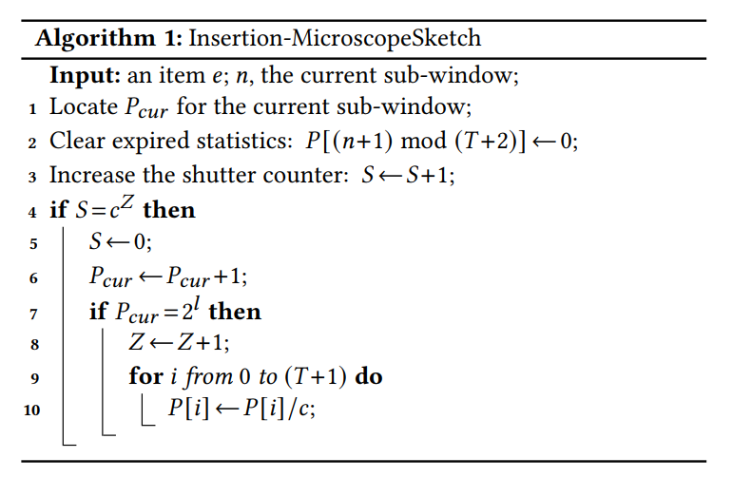
MicroscopeSketch (MicroSketch)
Insertion operation
$$f_{i}=P_{i}×c^{Z}$$
$$P_{cur}=P[n mod (T+2)]$$
zero counter $=P[(n+1) mod (T+2)]$
For the shutter counter:
We normally do not clean the shutter counter at the end of each sub–window. Instead, we let the next sub-window inherit the remaining frequency.
zoom-out
Notes:
Next, we introduce the specific operations that interact with this data structure.
We start from the insertion Operation.
When a new item shows up, it gets hashed into several lines, and each of these lines needs an update. Here, we're focusing on how the insertion operation for one of these lines works.
First, let's say we're in the current sub-window, which we'll call 'n'. The counter that matches 'n mod (T+2)' is the pixel counter for this sub-window.
We start by identifying the counter associated with the most recent sub-window, then we clear the following counter to get ready for the upcoming sub-window, which will be 'n+1'. After that, we increase the shutter counter 'S' by one. If 'S' reaches 'C^Z', it means the total remainders are enough to cause an increase in the floating-point significant digit. In this case, we clear 'S' and increase the pixel counter of the current sub-window.
Remember how we mentioned that the size of each pixel counter is 'l' bits? When its value hits '2^l', it's reached its max. When that happens, we need to zoom out: we increase 'Z' by one, and all pixel counters are divided by 'c' to prevent them from overflowing.
At the end of a sub-window, the shutter counter 'S' doesn't get emptied. Its value will be passed on to the next window. This way, the shutter counter 'S' effectively shifts some of the frequency from its current sub-window to the future windows.

Slide 11
MicroscopeSketch (MicroSketch)
Zoom-in operation
At the end of every sub-window, we check whether all pixel counters 𝑃[0],𝑃[1],···,𝑃[𝑇 +1] are smaller than $\frac{2^{l}}{c}$. If so, we multiple all the pixel counters by 𝑐 and decrement the zooming counter by 1.
To achieve a more accurate estimation when the frequency becomes small.
Notes:
The **Zoom-in Operation** is like doing the opposite of the Zoom-out operation.
When we see that every pixel counter's value stays below \( 2^l \) divided by c, we can multiply each one by c without the worry of overflows. After that, we decrement the value of the zooming counter Z. This helps us make our recordings more detailed, especially when the numbers start to go down.
Some people might worry about how long these checks take. They might think that these steps will take too much time. But in practice, we can make them work fast. For example, we don't have to check all the time; we can just do it only when both the zero counter is reset and the reset value meets certain rules. This way, we can keep things correct and fast.

Slide 12
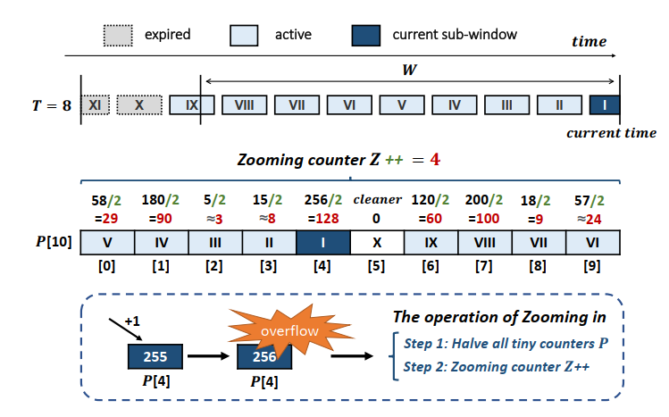
MicroscopeSketch (MicroSketch)
Insertion example
$$l=8, c=2$$
Notes:
In the illustrated example, let's imagine the diagram showing different pixel counters in sequence. The present moment is aligned with pixel counter 4. The previous time window corresponds to pixel counter 3, and the pattern continues backward.
Now, as data flows in and a new item causes the value within pixel counter 4 to hit 256, we're faced with an overflow situation. To counteract this and to prevent potential overflow in other pixel counters as well, every pixel counter is divided by 2. Following this division, the zooming counter Z is incremented to adjust for the change in scale. This ensures that our structure remains accurate and efficient in representing the data even as frequencies change.

Slide 13
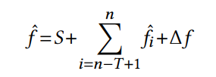
MicroscopeSketch (MicroSketch)
Query operation
The frequency of $i^{th}$ sub-window:
the frequency of ${(T+1)}^{th}$ sub-window
The frequency of the sliding window (three parts):
Three methods to compute $∆f$:
Linear approximation:
Overestimation method:
Underestimation method:
Notes:
To discern the frequencies within each window, we resort to the floating-point representation, which yields \( fi \).
The cumulative frequency within the sliding window can be estimated by the sum of three parts:
1. The first segment is S, which is the remainder.
2. The next segment is the aggregate of \( fi \) for the latest T sub-windows.
3. Lastly, the term \( delta f \) indicates the frequency within the section demarcated in red. This section illustrates the overlap of the sliding window with the T+1-th window.
To compute \( delta f \), we can use one of three distinct strategies:
1. **Linear Approximation**: If the primary objective is high accuracy, the linear approximation method is apt. Through this approach, the frequency is deduced based on the fraction of the segment that's overlapped.
2. **Overestimation**: If the aim is to ensure a conservative overestimation, one can simply incorporate the full frequency of the T+1-th window.
3. **Underestimation**: For an underestimation, the most recent non-zero frequency is subtracted. This action is carried out to mitigate the residual effects birthed by remainders and scaling adjustments.

Slide 14
Applications
Upgrade various approximate algorithms
Count-Min Sketch
CU Sketch
Heavy Gaudian
Space Saving
For frequency estimation
For finding top-k frequent items and the top-k heavy changes
Algorithms
Tasks
Notes:
Our MicroSketch offers versatile integration capabilities, making it seamlessly adaptable with a variety of existing algorithms. By substituting their conventional counting mechanisms with our technology, these algorithms are instantly upgraded to support sliding window functionality.
A prime example of such integration is its applicability within the CM sketch. But the potential doesn't stop there.
The MicroSketch can also be combined with other approximate, such as the CU sketch and Heavy Guardian.
With this enhanced capability, not only can we provide high-accuracy frequency estimations within a sliding window, but we can also find the top-k frequent items and the top-k heavy changes

Slide 15
Experiments on Frequency Estimation
Notes:
In tasks related to frequency estimation, our experiments showed that we improved accuracy by almost ten times, while maintaining the same memory usage. We benchmarked our method against others in the field, such as Sliding Sketch, ECM, and SHE. Our strategy stood out and demonstrated its efficiency in both count-based and time-based sliding window definitions. When tested across various datasets, we observed consistent and promising results.

Slide 16
Experiments on Frequency Estimation
Notes:
Through efficient code implementation, our algorithm demonstrates enhanced speed compared to existing solutions.

Slide 17
Experiments on Finding Top-k Frequent Items
Notes:
Regarding the task of identifying the top-k frequent items within a sliding window, our algorithm exhibited commendable accuracy. By integrating our techniques into Heavy Guradian and SpaceSaving, both algorithms were augmented to detect within sliding windows, whereas they were originally designed solely for fixed windows.

Slide 18
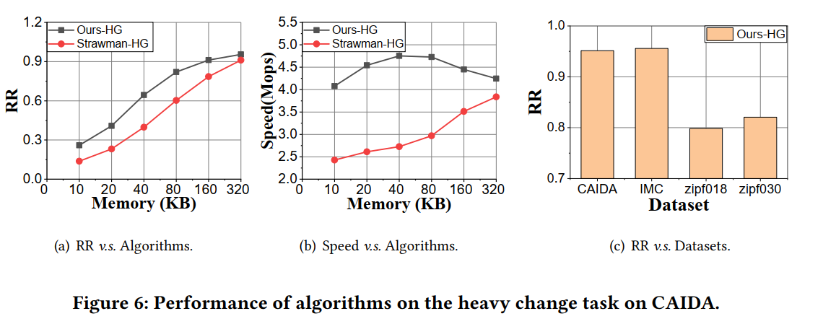
Experiments on Finding Top-k Heavy Changes
This task compares the MicroSketch with the straw man solution, which splits the sliding window into sub-windows and keeps a counter for each sub-window.
Notes:
Furthermore, our algorithm can also find the top-k heavy changes within sliding windows.

Slide 19
Conclusion
Frequency estimation in sliding windows
Improve the accuracy under the same memory
Our key insight is the similarity of counter values across different sub-windows.
Notes:
In conclusion, we explore the frequency estimation in sliding windows, and improve its accuracy under the same memory. Our key insight is the similarity of counter values across different sub-windows.
Thank you for your attention!
Questions are welcome!

Slide 20
Q&A

Slide 21
Applications
Frequency estimation
MicroSketch-CU
Insertion: 1) When inserting an item 𝑒, we increment the MicroSketch with the smallest frequency in the current sub-window among the 𝑑 mapped ones. The frequency in the current counter is $S+P_{cur}∗c^{Z}$ ; 2) We clear the shutter counter 𝑆 at the end of each sub-window and
increment $P_{cur}$ by 1 with probability $\frac{S}{c^{Z}}$.
Query: When querying an item 𝑒, we report the sum of three parts: 1) the smallest shutter counter 𝑆 among the 𝑑 mapped ones, 2) the sum of $\underline{P_{i}}$ in the recent 𝑇 sub-windows, and 3) the smallest Δ𝑓 among the 𝑑 mapped ones, where $\underline{P_{i}}$ is the smallest pixel counter in the $i^{th}$ sub-window among the 𝑑 MicroSketches.
Conclusion: MicroSketch-CU can achieve the only overestimation by using the overestimation query of MicroSketch.

Slide 22
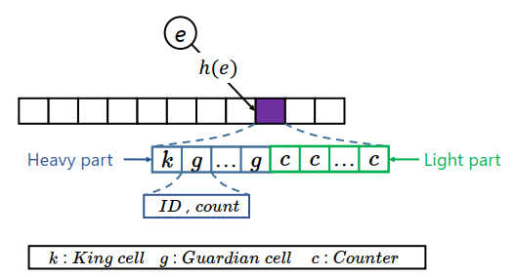
Applications
Finding top-k frequent items
MicroSketch-HG
We use a MicroSketch to replace each value of the KV pairs in HeavyGuardian.
Insertion: When inserting an item 𝑒, we first use a hash function ℎ(𝑒) to map 𝑒 to a bucket. Now assume that 𝑒 is mapped to the $i^{th}$ bucket. Then, there are three cases:
If 𝑒 already exists in the bucket, its frequency will be increased by using the Insertion operation of MicroSketch.
If 𝑒 is not recorded in the bucket, but the bucket has an empty cell, 𝑒 will be inserted into the empty cell with a frequency of 1.
If 𝑒 is not recorded in the bucket and the bucket is full, we will decay the weakest guardian with a probability. Assuming that the frequency of the weakest MicroSketch guardian is $f_{i}^{∗}$, we use the deletion operation of MicroSketch to decrease $f_{i}^{∗}$ by 1 with probability $β^{{−f}_{i}^{∗}}$ where 𝛽 is a constant (e.g., 𝛽 =1.08). After the decay, if $f_{i}^{∗}$ becomes 0, we insert 𝑒 into the weakest MicroSketch guardian.

Slide 23
Applications
Finding top-k frequent items
MicroSketch-HG
Top-k report: To get the top-𝑘 frequent items from MicroSketchHG, we traverse all KV pairs and report the 𝑘 KV pairs with the highest frequency.
Conclusion: MicroSketch-HG can achieve the only underestimation by using the underestimation query of MicroSketch.

Slide 24
Applications
Finding top-k frequent items
MicroSketch-SS
The main idea of SpaceSaving is to always use the incoming item to replace the weakest guardian and increment it by 1.
Insertion: We only need to modify the third case above of MicroSketch-HG as follows: If 𝑒 is not recorded in the bucket and the bucket is full, we increase the frequency of the weakest guardian by 1. Then, we replace the ID of the weakest guardian by 𝑒.
Conclusion: MicroSketch-SS can achieve the only overestimation by using the overestimation query of MicroSketch.

Slide 25
Applications
Finding top-k heavy changes
MicroSketch-HG
We still use the data structure and operations of MicroSketch-HG but do some changes.
Insertion: We extend the number of pixel counters to 2𝑇 + 2, where 𝑇 is the number of sub-windows of the sliding window. Assume that the current time is 𝑡, we compute the frequency of 𝑒 in the sliding window ranging from time 𝑡 −2·𝑊 to 𝑡 −𝑊 , which is denoted by $f_{1}^{^}$ , and the frequency from time 𝑡 −𝑊 to 𝑡, which is denoted by $f_{2}^{^}$, using the query operation of MicroSketch.
Top-k report: To get the top-𝑘 heavy changes from MicroSketchHG, we traverse all KV pairs and report the 𝑘 KV pairs whose | $f_{1}^{^}$− $f_{2}^{^}$| is highest.

