Slide 1
CodingSketch: A Hierarchical Sketch with Efficient Encoding and Recursive Decoding
ICDE 2024, May 13-17, 2024, Utrecht，Netherlands.
Qizhi Chen†, Yisen Hong†, Yuhan Wu†, Tong Yang†, Bin Cui†
† Peking University, China
Notes:
Hello everyone, I’m QiZhi Chen from Peking University. I’m going to introduce CodingSketch: A Hierarchical Sketch with Efficient Encoding and Recursive Decoding

Slide 2
01
Part One
Background

Slide 3
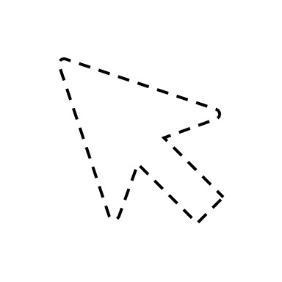
Background: Frequency Estimation
Now
Item(s)
Upcoming
Coming
Has come
Data Stream
1
2
1
Notes:
Firstly, I want to talk about the frequency estimation task in data streams.
Frequency estimation involves determining how often each item appears in a data stream. It's a simple yet crucial operation, serving as the foundation for more complex tasks such as heavy hitter detection, join size estimation, and network traffic monitoring.

Slide 4
Background: Frequency Estimation
Now
Item(s)
Upcoming
Coming
Has come
Data Stream
1
2
1
Notes:
Firstly, I want to talk about the frequency estimation task in data streams.
Frequency estimation involves determining how often each item appears in a data stream. It's a simple yet crucial operation, serving as the foundation for more complex tasks such as heavy hitter detection, join size estimation, and network traffic monitoring.

Slide 5
Background: Frequency Estimation
Now
Item(s)
Upcoming
Coming
Has come
Data Stream
1
3
1
Notes:
Firstly, I want to talk about the frequency estimation task in data streams.
Frequency estimation involves determining how often each item appears in a data stream. It's a simple yet crucial operation, serving as the foundation for more complex tasks such as heavy hitter detection, join size estimation, and network traffic monitoring.

Slide 6
Background: Frequency Estimation
Now
Item(s)
Upcoming
Coming
Has come
Data Stream
2
3
1
Notes:
Firstly, I want to talk about the frequency estimation task in data streams.
Frequency estimation involves determining how often each item appears in a data stream. It's a simple yet crucial operation, serving as the foundation for more complex tasks such as heavy hitter detection, join size estimation, and network traffic monitoring.

Slide 7
Background: Frequency Estimation
Now
High Speed
Large Volume
Limited Space
Item(s)
Upcoming
Coming
Has come
Approximate
Data Stream
2
3
1
Sketch
Notes:
Data streams present unique challenges due to their high speed, large volume, and the limited space available for processing. Traditional data structures struggle to keep up with these demands, leading to inefficiencies.
To address these challenges, we introduce probabilistic data structures, which are designed to provide accurate estimates while maintaining a small memory footprint. Among these, the sketch is one of the most widely used and effective techniques.

Slide 8
Background: Count-Min Sketch
Data Structure:
a counter array $A$ with width $w$.
$d$ hash functions $h_{1}\left(⋅\right),⋯,h_{d}\left(⋅\right)$，each of which maps an item $e$ to a counter.
Insert: $A\left[h_{i}\left(e\right)\right]+=1, ∀ i=1,⋯,d$
Query: $\min\left[h_{1}\left(e\right),⋯,h_{d}\left(e\right)\right]$
C
C
B
A
C
C
B
A
 |  | 2 |  | 2 |  | 1 |  | 1 | 2 |  |  | 3 |  | 1
CM sketch with $w=16, d=3$
Notes:
The Count-Min sketch, or the CM sketch for short, is one of the most widely used sketches. Let me briefly introduce the CM sketch Next.
As shown in the figure, a CM sketch contains an array of counters, and in this case, the width is 16. A CM sketch is also associated with several independent hash functions, each of which can map an item to a counter uniformly and randomly.

Slide 9
Background: Count-Min Sketch
Data Structure:
a counter array $A$ with width $w$.
$d$ hash functions $h_{1}\left(⋅\right),⋯,h_{d}\left(⋅\right)$，each of which maps an item $e$ to a counter.
Insert: $A\left[h_{i}\left(e\right)\right]+=1, ∀ i=1,⋯,d$
Query: $\min\left[h_{1}\left(e\right),⋯,h_{d}\left(e\right)\right]$
C
C
B
A
C
C
B
A
 |  | 3 |  | 2 |  | 1 |  | 2 | 2 |  |  | 3 |  | 2
CM sketch with $w=16, d=3$
Notes:
To insert an incoming item, the CM sketch first uses hash functions to locate several counters, and increases each of these counters by one. The slide shows the process of inserting four items A, B, C, and C into the CM sketch.

Slide 10
Background: Count-Min Sketch
Data Structure:
a counter array $A$ with width $w$.
$d$ hash functions $h_{1}\left(⋅\right),⋯,h_{d}\left(⋅\right)$，each of which maps an item $e$ to a counter.
Insert: $A\left[h_{i}\left(e\right)\right]+=1, ∀ i=1,⋯,d$
Query: $\min\left[h_{1}\left(e\right),⋯,h_{d}\left(e\right)\right]$
C
C
B
A
C
C
B
A
 |  | 4 |  | 2 |  | 2 |  | 2 | 2 |  |  | 4 |  | 2
CM sketch with $w=16, d=3$
Notes:
To insert an incoming item, the CM sketch first uses hash functions to locate several counters, and increases each of these counters by one. The slide shows the process of inserting four items A, B, C, and C into the CM sketch.

Slide 11
Background: Count-Min Sketch
Data Structure:
a counter array $A$ with width $w$.
$d$ hash functions $h_{1}\left(⋅\right),⋯,h_{d}\left(⋅\right)$，each of which maps an item $e$ to a counter.
Insert: $A\left[h_{i}\left(e\right)\right]+=1, ∀ i=1,⋯,d$
Query: $\min\left[h_{1}\left(e\right),⋯,h_{d}\left(e\right)\right]$
C
C
B
A
C
C
B
A
 |  | 4 |  | 3 |  | 2 |  | 2 | 3 |  |  | 5 |  | 2
CM sketch with $w=16, d=3$
Notes:
To insert an incoming item, the CM sketch first uses hash functions to locate several counters, and increases each of these counters by one. The slide shows the process of inserting four items A, B, C, and C into the CM sketch.

Slide 12
Background: Count-Min Sketch
Data Structure:
a counter array $A$ with width $w$.
$d$ hash functions $h_{1}\left(⋅\right),⋯,h_{d}\left(⋅\right)$，each of which maps an item $e$ to a counter.
Insert: $A\left[h_{i}\left(e\right)\right]+=1, ∀ i=1,⋯,d$
Query: $\min\left[h_{1}\left(e\right),⋯,h_{d}\left(e\right)\right]$
C
C
B
A
C
C
B
A
 |  | 4 |  | 4 |  | 2 |  | 2 | 4 |  |  | 6 |  | 2
CM sketch with $w=16, d=3$
Notes:
To estimate the frequency of an item, such as C, the CM sketch will return the minimum value of all hashed counters. In this case, the frequency of item C is estimated to be the minimum value of 4, 4, and 6, that is, 4.

Slide 13
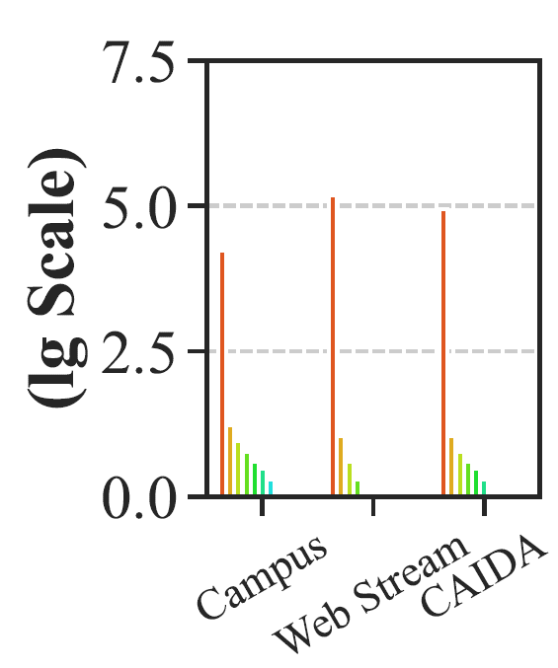
Background: Flow Size Distribution
Flow Size Distribution
Allocating appropriate counter size
The numbers (the logarithm to base 10) of items of the top 0% (the max), 10%, 20%, ..., 90%, 100% (the min) flows in each dataset.
Web Stream dataset: http://fimi.ua.ac.be/data/.
CAIDA dataset: http://www.caida.org/data/overview/.
More counters
The max flow appears more than 100,000 times.
Lower error
Most flows appear less than 10 times.
Notes:
Following the introduction of the Count-Min (CM) Sketch, it's important to discuss the advancements made with sketches like Stingy and Pyramid. These sketches leverage the high skewness distribution of real-world datasets to optimize memory usage and accuracy of sketch.
High skewness means that a small number of items occur very frequently while the majority occur rarely. To manage this, those sketches use hierarchical structures. They start with small counters at the base layer, which overflow to higher layers when needed. This hierarchical approach helps to efficiently manage memory and reduce errors from overflow.

Slide 14
02
Part Two
Algorithm
Notes:
Next, we introduce our algorithm, CodingSketch.

Slide 15
Our Discovery
Now
Item(s)
Upcoming
Coming
Has come
Data Stream
...
sketch
dynamic query?
Notes:
We observed that in many scenarios, such as frequency estimation and join size estimation, dynamic querying during the insertion process is not necessary. Instead, queries and analyses are performed after all elements have been inserted.

Slide 16
Our Discovery
Now
All Items Have come
Data Stream
...
sketch
then query
Notes:
We observed that in many scenarios, such as frequency estimation and join size estimation, dynamic querying during the insertion process is not necessary. Instead, queries and analyses are performed after all Items have been inserted.

Slide 17
Our Discovery
Now
Item(s)
Upcoming
Coming
Has come
Data Stream
Encoding
...
smaller sketch
Notes:
This allows us to use better encoding algorithms during the insertion phase, resulting in a more compact data structure. Once all items have been inserted, we can then apply a decoding algorithm to retrieve the original sketch.

Slide 18
Our Discovery
Now
All Items Have come
Data Stream
Encoding
Decoding
...
...
smaller sketch
original sketch
Notes:
This allows us to use more sophisticated encoding algorithms during the insertion phase, resulting in a more compact data structure. Once all elements have been inserted, we can then apply a decoding algorithm to retrieve the original sketch.

Slide 19
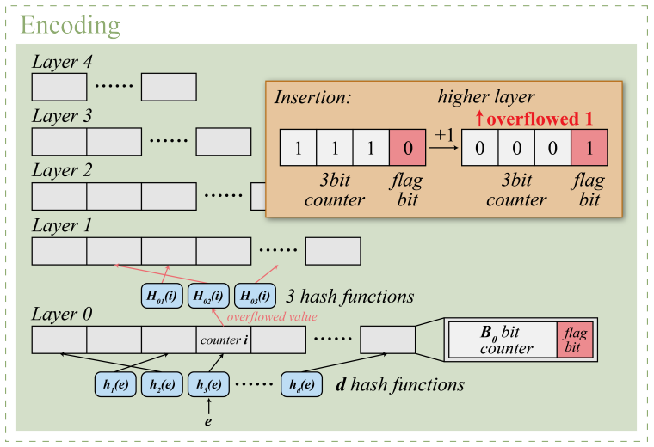
Encoding Algorithm
Bottom-up encoding
Multiple pointers to upper layers
Reduces memory usage
Notes:
In CodingSketch, we use a bottom-up encoding process to handle the skewed frequency distribution efficiently. Each item is inserted into multiple counters at the lowest layer. When a counter overflows, its value is propagated to the upper layers through multiple pointers. This method significantly reduces memory usage by efficiently managing overflow values.

Slide 20
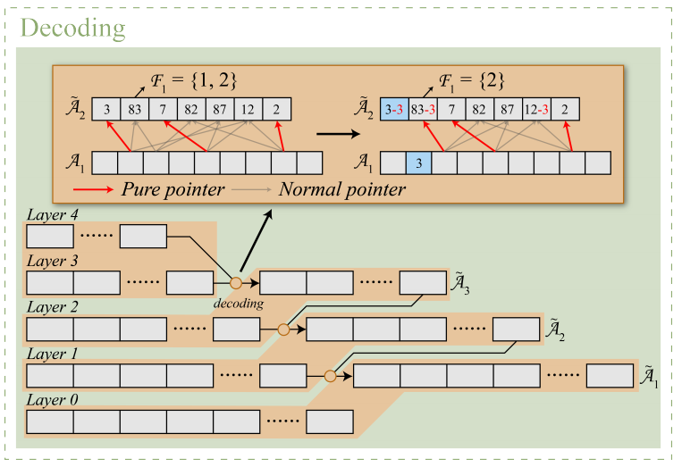
Decoding Algorithm
Top-down decoding
Pure pointer identification
Accurate retrieval of overflow values
Notes:
The decoding process in CodingSketch is performed top-down. During this recursive process, we identify 'pure pointers'—pointers that uniquely indicate overflow values. By following these pure pointers, we can accurately retrieve the overflow values from the upper layers, ensuring error-free frequency estimations.

Slide 21
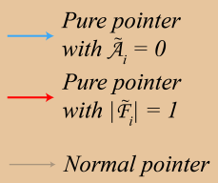
Flagless Pruning
Eliminates flag bits
Saves significant memory
Supports deletion operations
Notes:
CodingSketch introduces the flagless pruning technique to eliminate the need for additional flag bits, which traditionally indicate overflow. This innovation not only saves significant memory but also allows for efficient deletion operations. By assuming all counters in the current layer have overflowed and using explicit and implicit pruning, we can maintain the integrity and accuracy of the data structure.

Slide 22
Flagless Pruning
Eliminates flag bits
Saves significant memory
Supports deletion operations
Notes:
CodingSketch introduces the flagless pruning technique to eliminate the need for additional flag bits, which traditionally indicate overflow. This innovation not only saves significant memory but also allows for efficient deletion operations. By assuming all counters in the current layer have overflowed and using explicit and implicit pruning, we can maintain the integrity and accuracy of the data structure.

Slide 23
03
Part Three
Experiments
Notes:
Next, we show some of the selected experimental results.

Slide 24
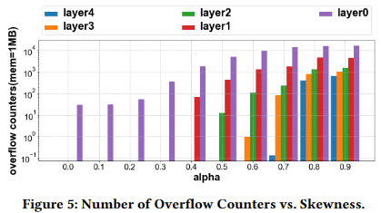
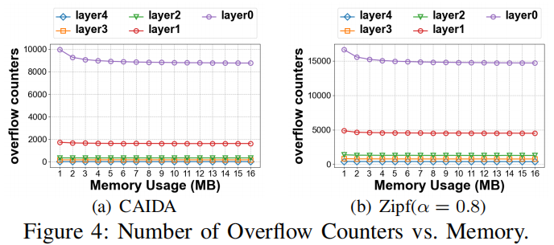
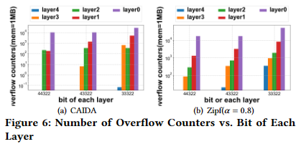
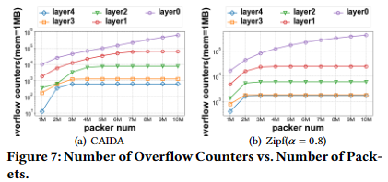
Experiments on Parameter Settings
Notes:
In the first part of our experiments, we explored the effects of various parameters on the performance of CodingSketch.
Our findings indicate that optimal parameter settings vary depending on the data distribution, highlighting the flexibility of CodingSketch in adapting to different scenarios.

Slide 25
Experiments on Accuracy
Notes:
Our evaluation shows that CodingSketch is ten times more accurate than the state-of-the-art sketches.
We conducted extensive simulation experiments to validate our claims.

Slide 26
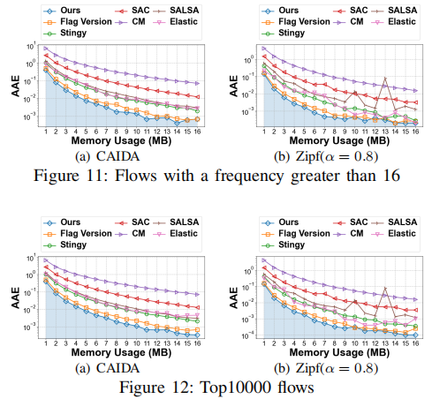
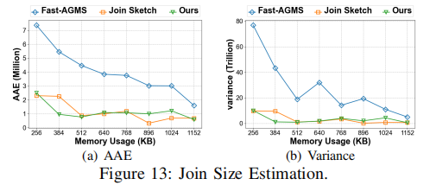
Experiments on Frequent Flows and Join Size Estimation
Notes:
In the third part of our experiments, we tested CodingSketch on extended tasks such as heavy hitter estimation and join size estimation. The results showed that CodingSketch excels in these complex tasks, demonstrating its versatility and effectiveness across different data stream processing applications.

Slide 27
Thank you
Our code is open-source!
https://github.com/CodingSketch/Coding-Sketch
Notes:
That is my talk. Our code is open-sourced in Github. Thank you!

